Slide 1
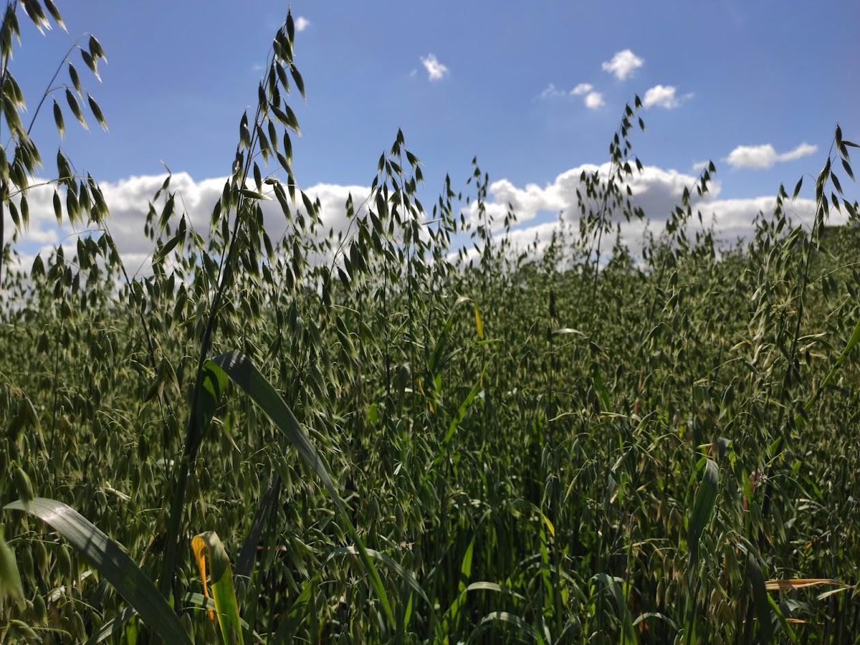
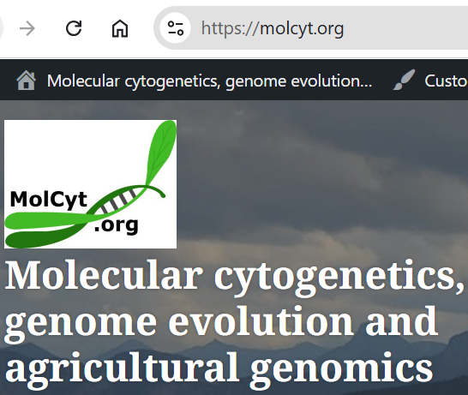
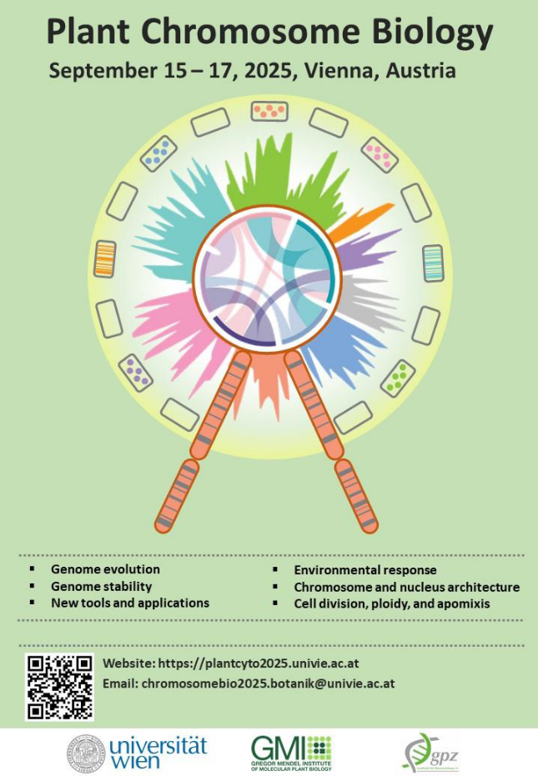
Cytogenomics of oats (Avena): genome evolution in action
Pat Heslop-Harrison,
Trude Schwarzacher,
Paulina Tomaszewska, Qing Liu
University of Leicester, Institute for Environmental Futures
South China Botanical Garden, Guangzhou, China,
University of Wroclaw, Wroclaw, Poland phh@molcyt.com

Slide 2
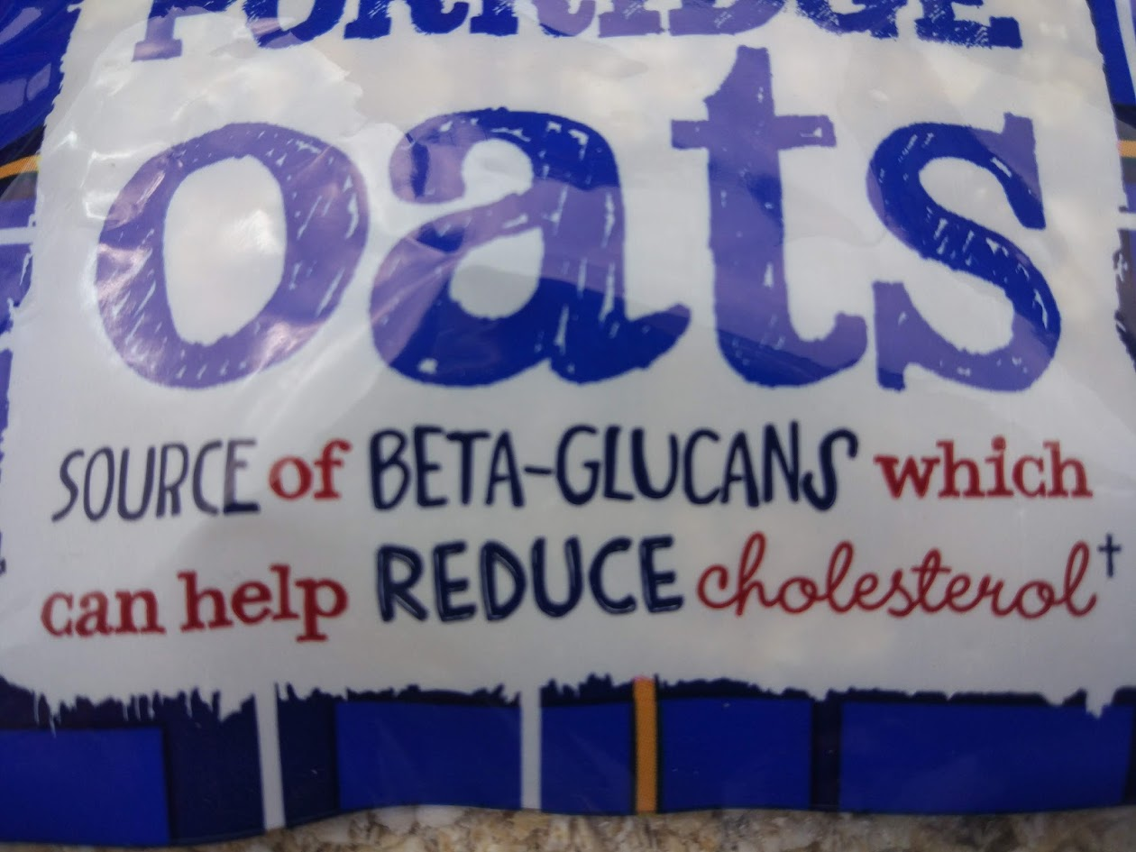
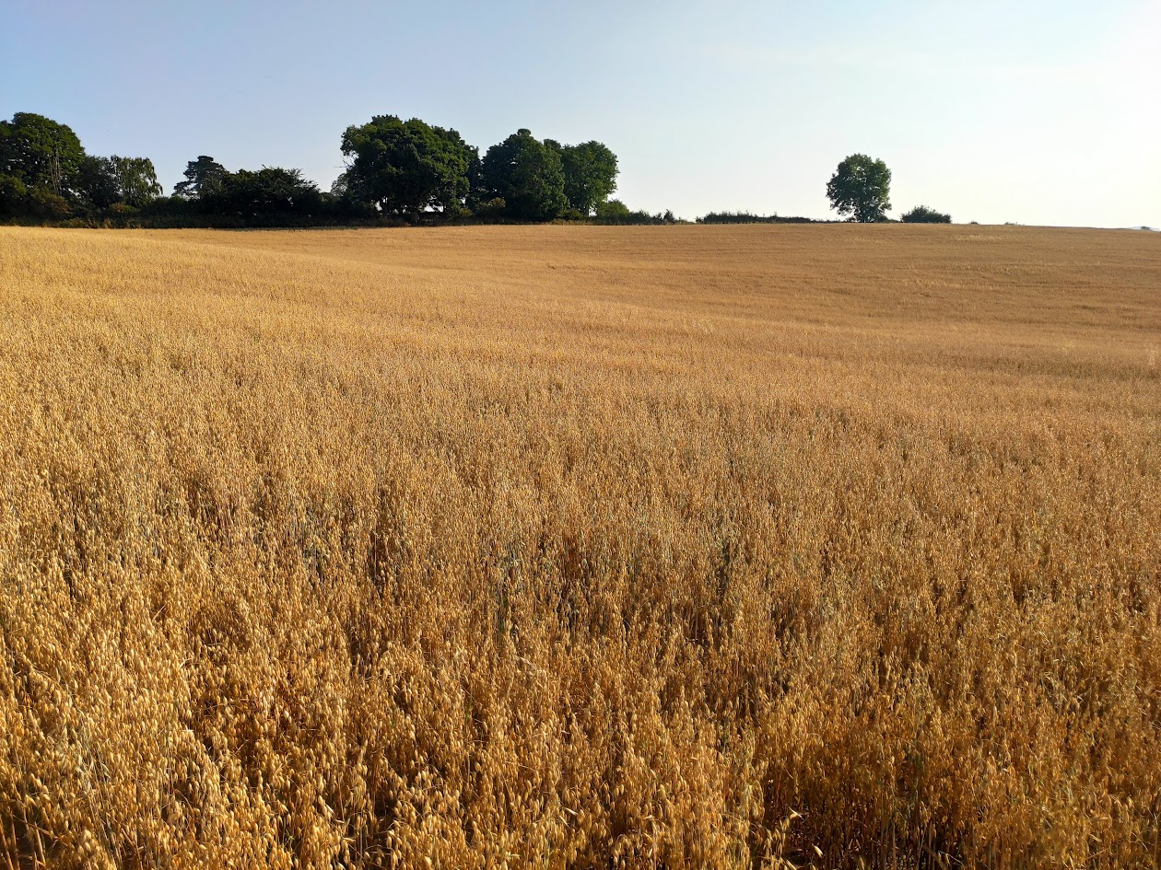
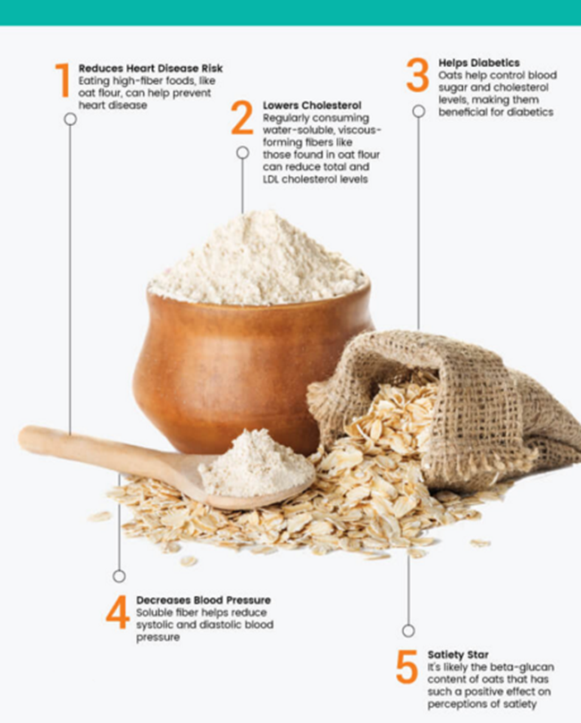
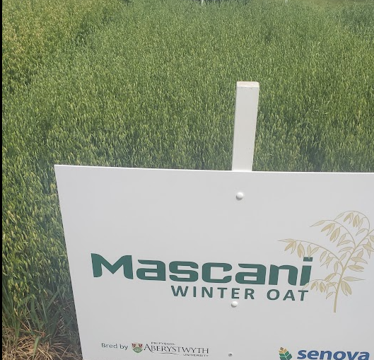

Slide 3
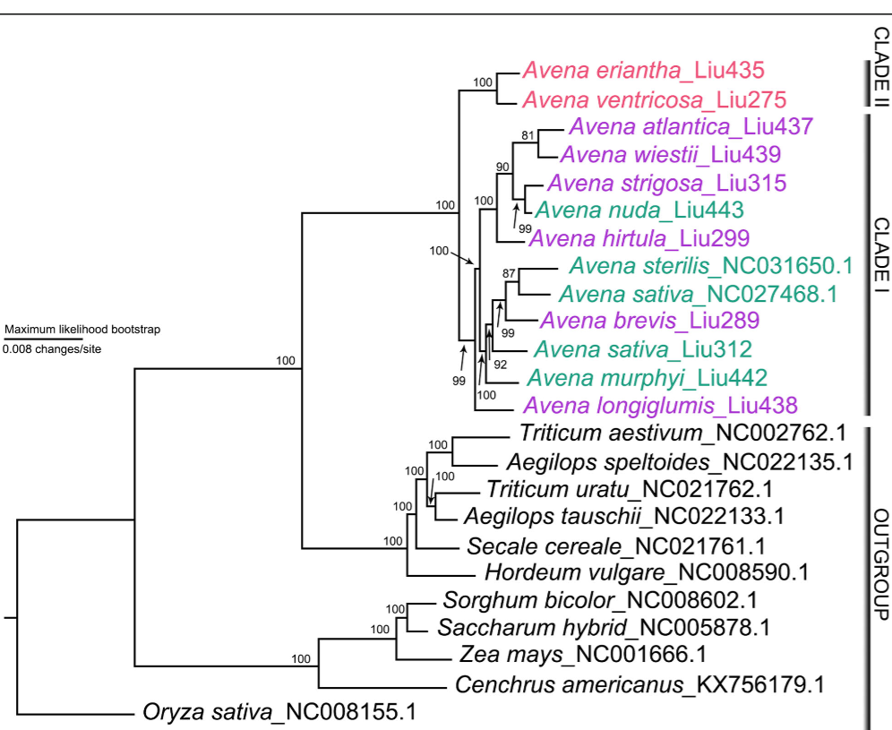
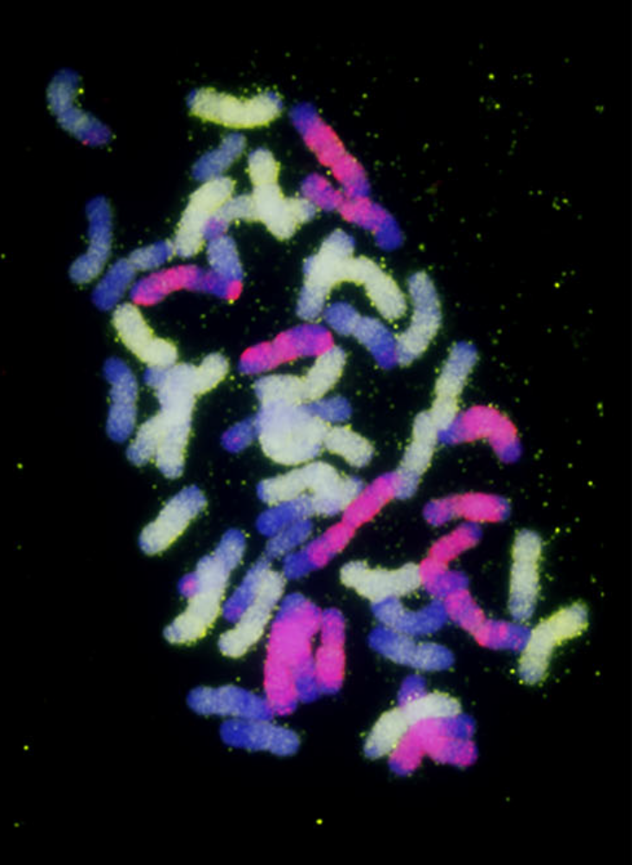
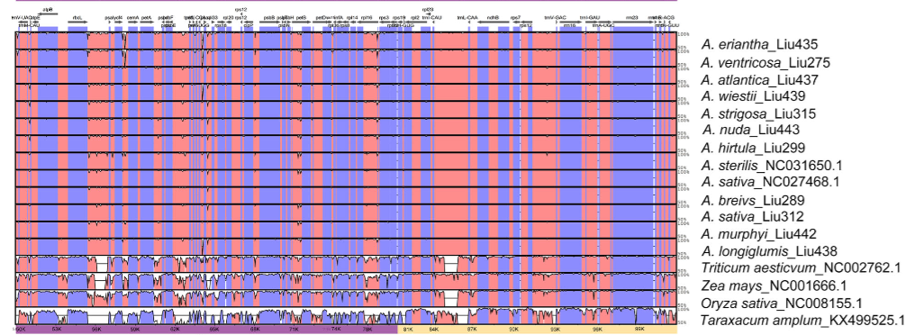
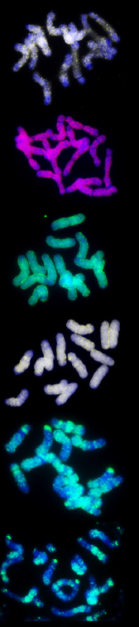
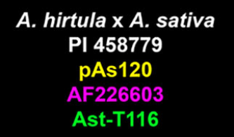
Purple A-genome (atl.str.-D); Red C-genome; Green polyploids
Chloroplast phylogeny: Qing Liu et al. BMC Biology
A, B, C, D genomes (+modifiers); all x=7
2n=8x-2=54; AsAsAACCDD
Paulina Tomaszewska 2022 Frontiers

Slide 4
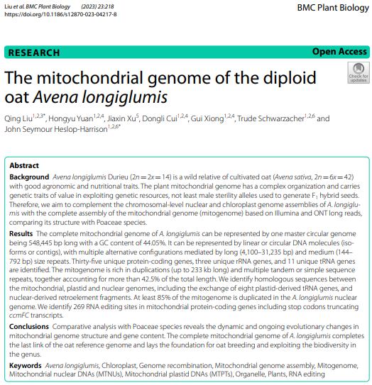
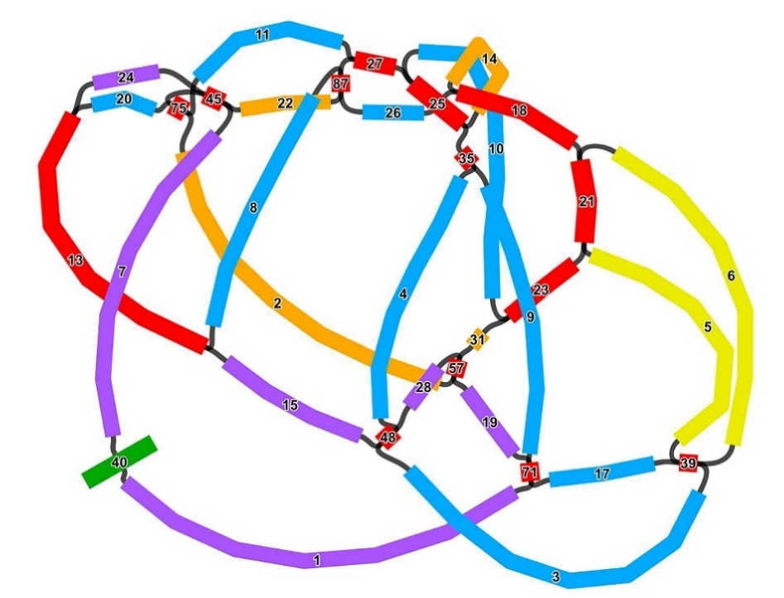
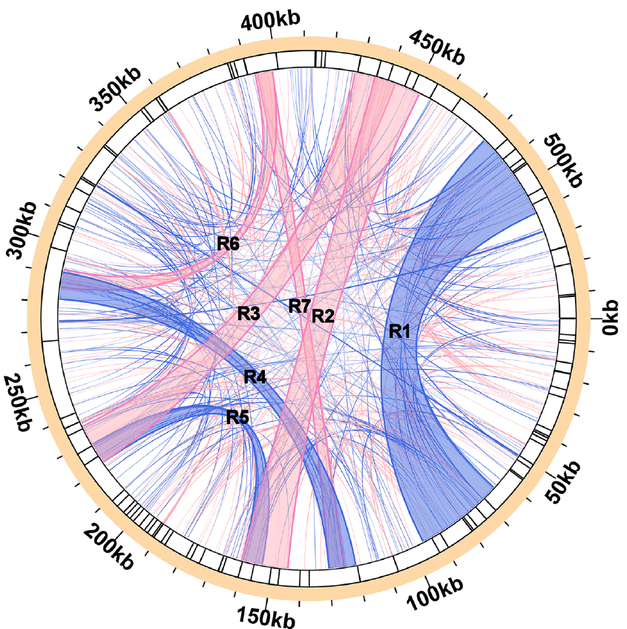
Complexity of mitochondrial genomes
Avena longiglumis
Sorghum bicolor
Recombination of the mitochondrial genome (isomers) mediated by long dispersed repeats (R1 to R7)
Gene exchange between both organellar and nuclear genomes is a continuous and dynamic evolutionary process
A. longiglumis 548 kb, and 39 protein-coding genes
Complex, repeat-mediated structure
BMC Plant Biology, 2023, 23, 218
Notes:
with long-molecule sequencing showing present of multiple alternative structures with repeat-mediated recombination. The total length was a large 548 kb, with only 39 protein-coding genes. A comparison of mitochondrial genomes with 23 Poaceae species showed that the gene exchange between the organelle genome and the nuclear genome of A. longiglumis has undergone a continuous and dynamic evolutionary process. Notably, building phylogenies based on sequences and the presence-or-absence of genes gave no sensible trees: not even the major Poaceae clades of PACMAD (Panicum/C4) and BOP

Slide 5
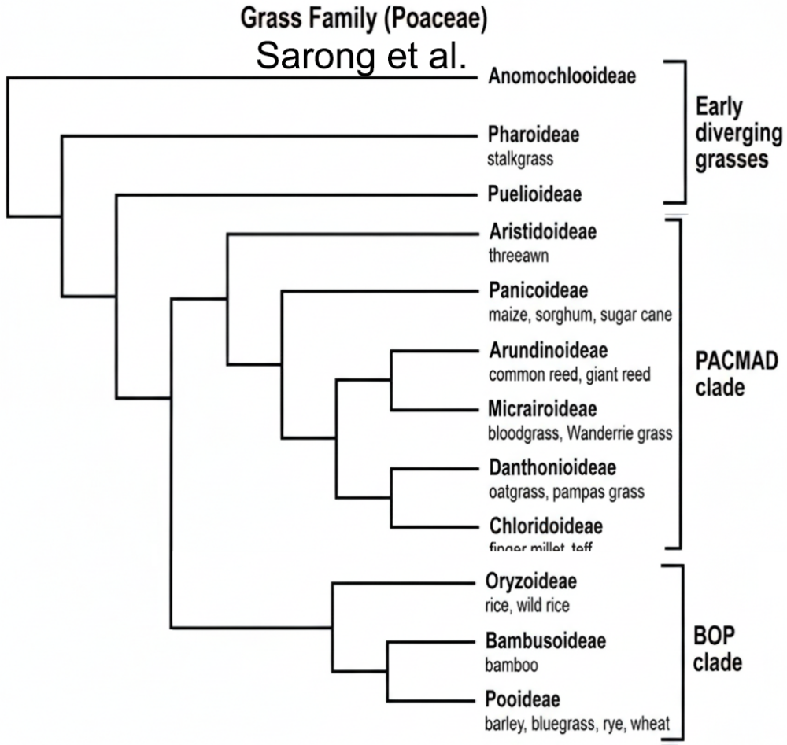
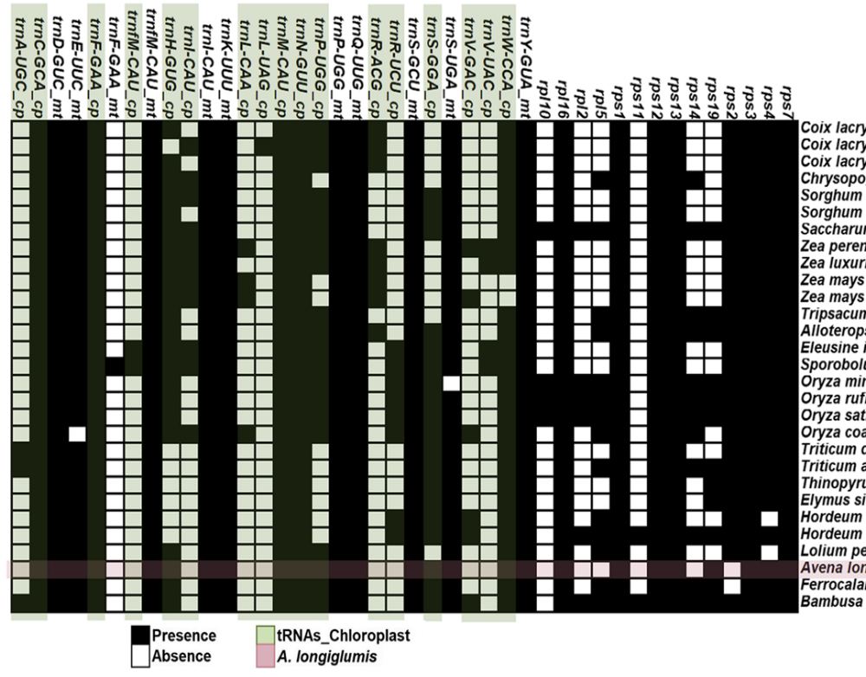
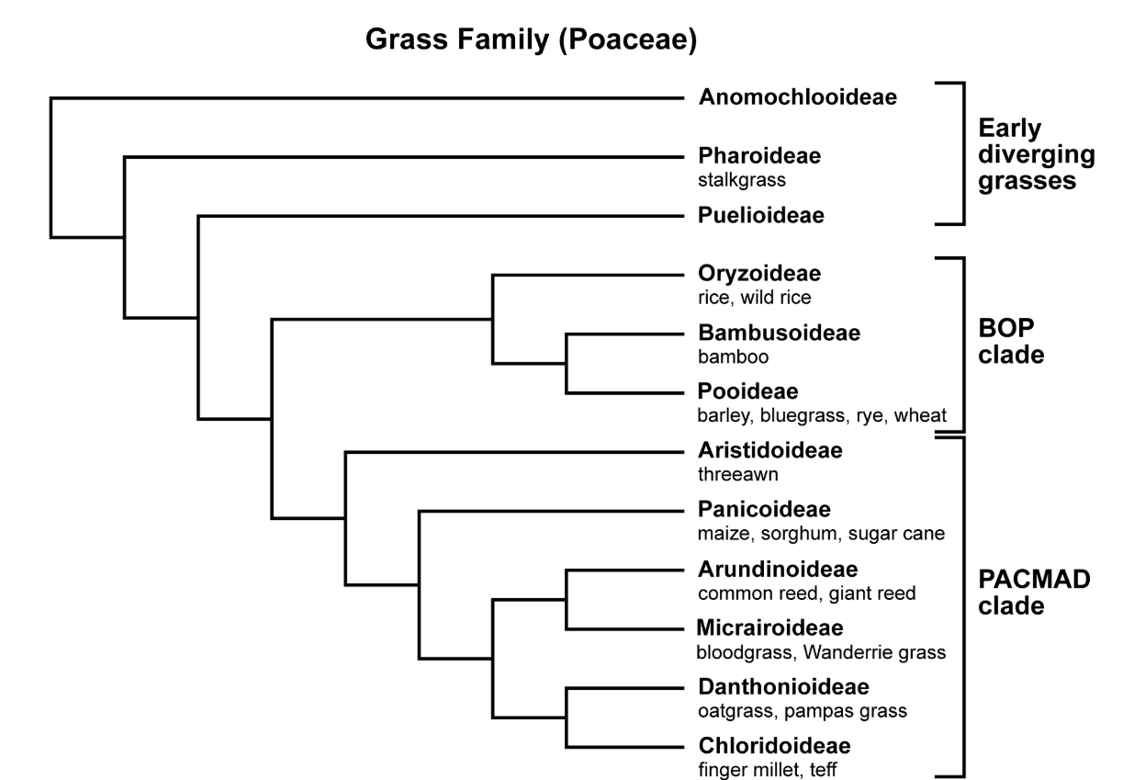
(Not) Explaining mitochondrial evolution
PACMAD
PACMAD
BOP
BOP
Soreng et al.
Sorghum bicolor
Qing Liu 2023
BOP and PACMAD are the two major divisions of the grasses. Mitochondrial genes do not separate them!
Notes:
We also reconstructed the complex mitochondrial genome A. longiglumis, with long-molecule sequencing showing present of multiple alternative structures with repeat-mediated recombination. The total length was a large 548 kb, with only 39 protein-coding genes. A comparison of mitochondrial genomes with 23 Poaceae species showed that the gene exchange between the organelle genome and the nuclear genome of A. longiglumis has undergone a continuous and dynamic evolutionary process. Notably, building phylogenies based on sequences and the presence-or-absence of genes gave no sensible trees: not even the major Poaceae clades of PACMAD (Panicum/C4) and BOP

Slide 6
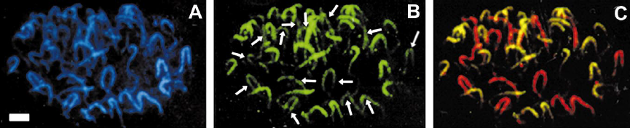
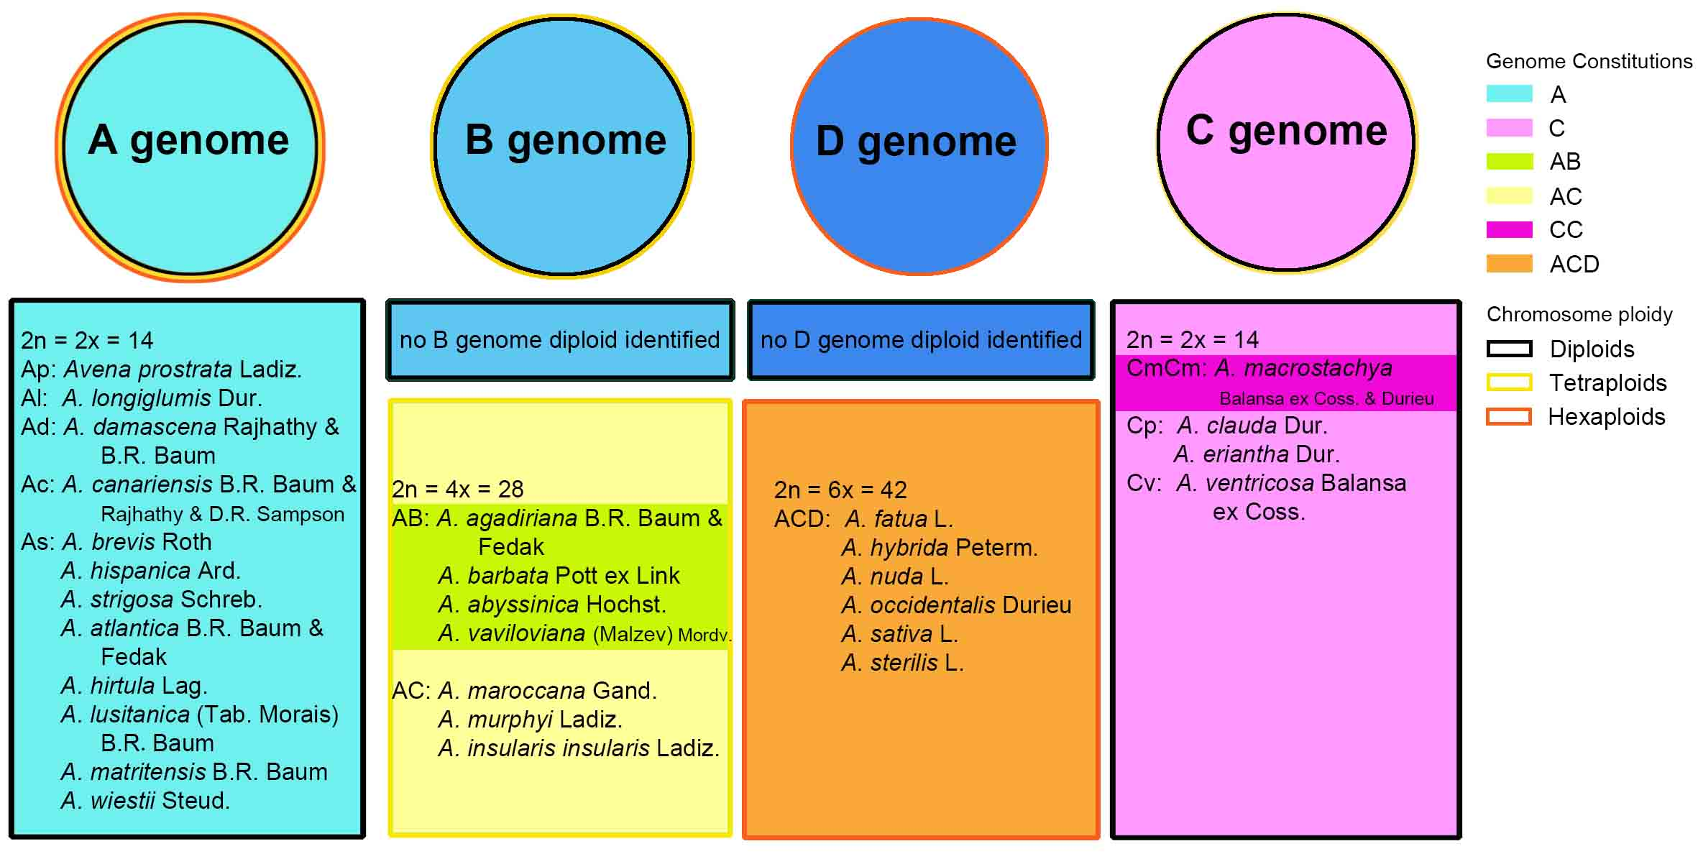
CoT=1 reassociated DNA from A genome and
ACD A. sativa hybridized to
Avena sativa chromosomes
Repetitive DNA, Genome and Species Relationships in Avena
Andreas Katsiotis & PHH 2000

Slide 7
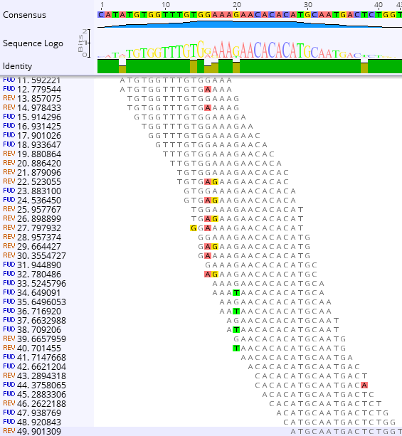
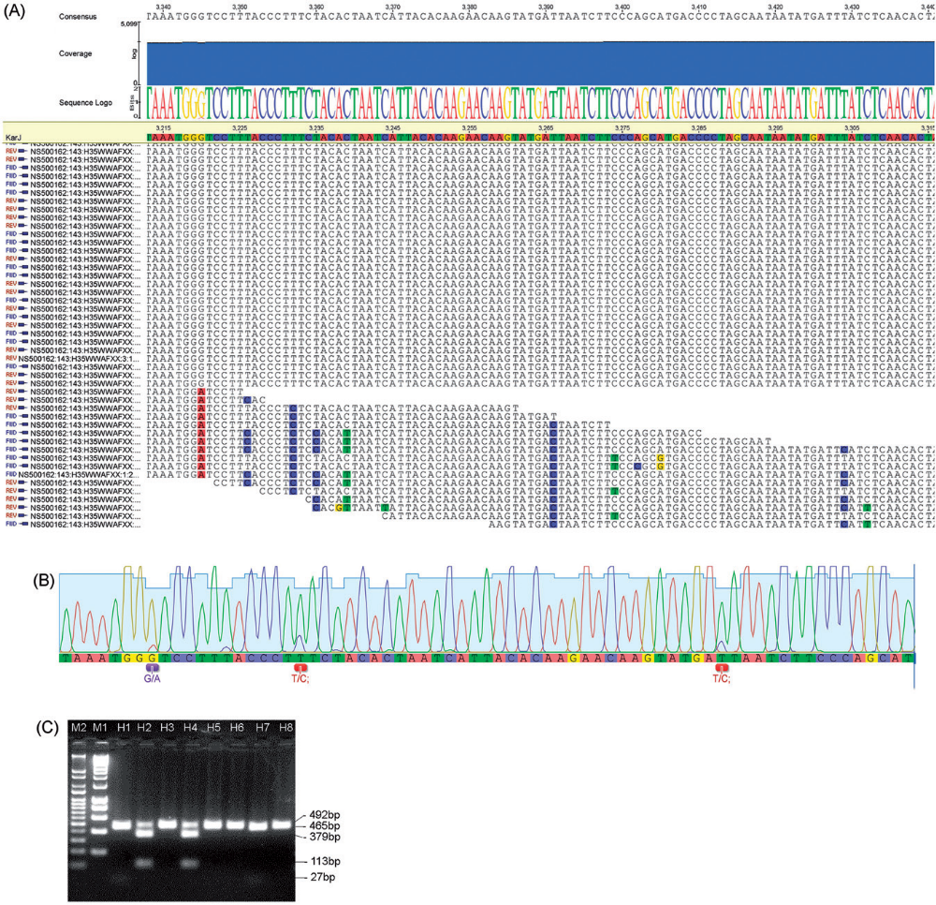
k-mer analysis
In 10Gb DNA sequence
16-mer (k=16): 2 billion canonical 16-mers; average 16-mer occurs 11 times in 22 Gb of sequence

Slide 8
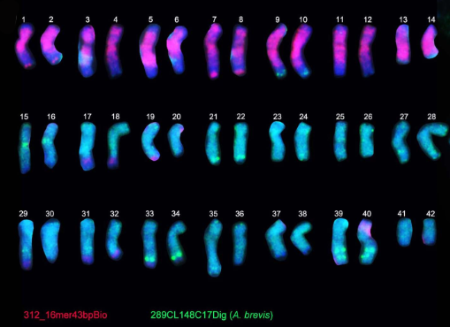
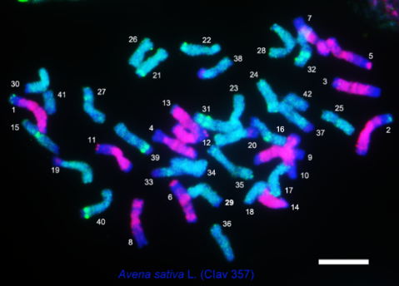
k-mer analysis
The most abundant 16-mer in A. sativa genome reads: CATATGTGGTTTGTGGAAAGAACACACATGCAATGACTCTGGT C-genome specific probe
occurs a total of 500K times
From 16-mer
GT500kb
Qing Liu. Repetitive DNA landscape in Avena
BMC Plant Biology. 2019 May 30;19(1):226.

Slide 9
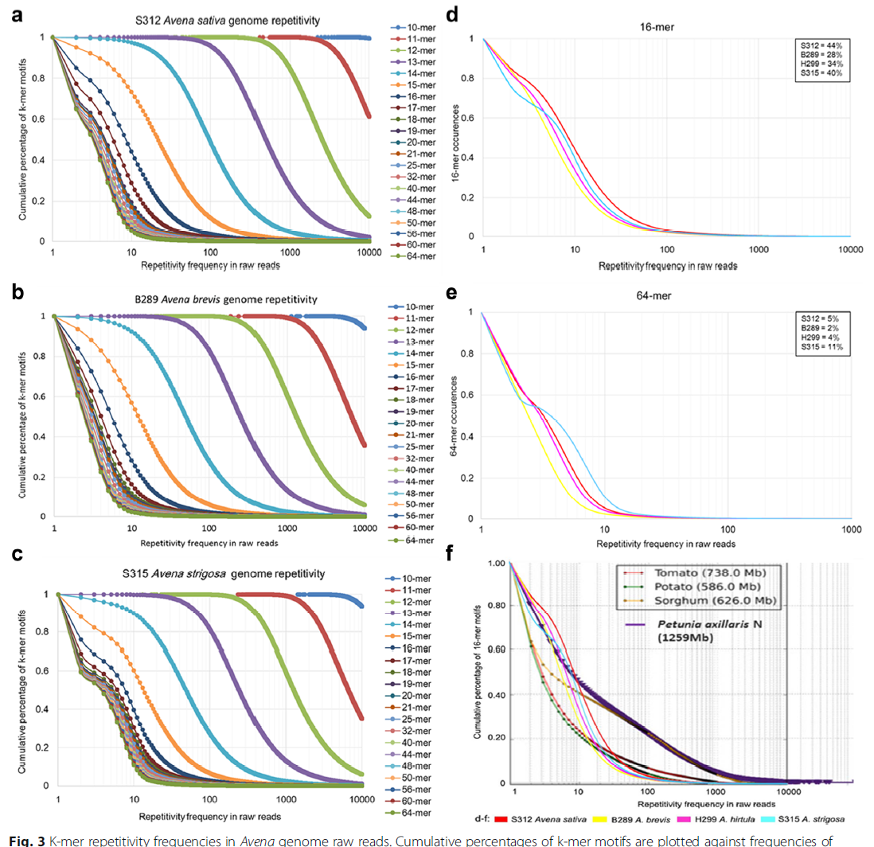
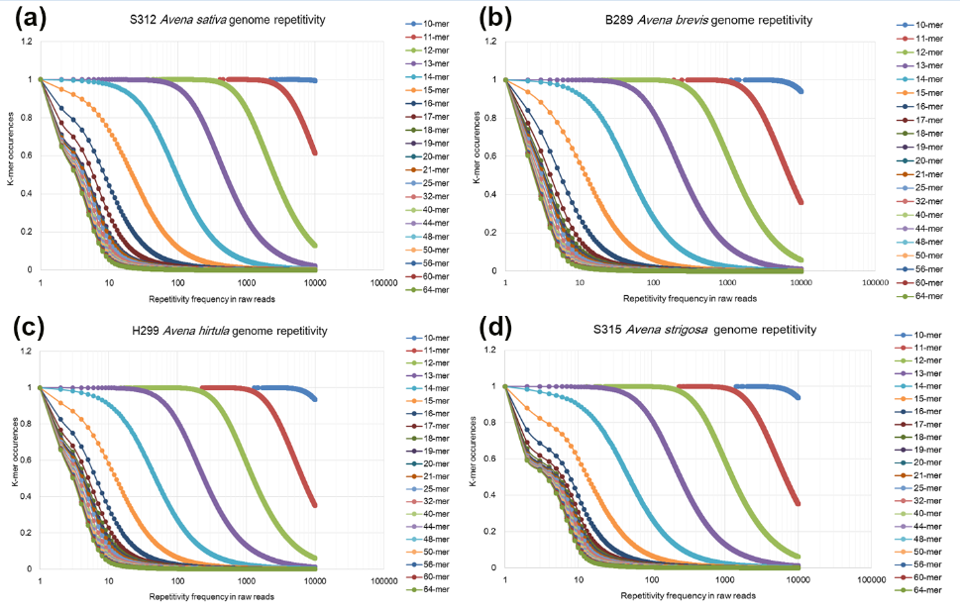
16-mers
occurring ≥1000 times
account for 44.21% of
cultivated oat genome

Slide 10
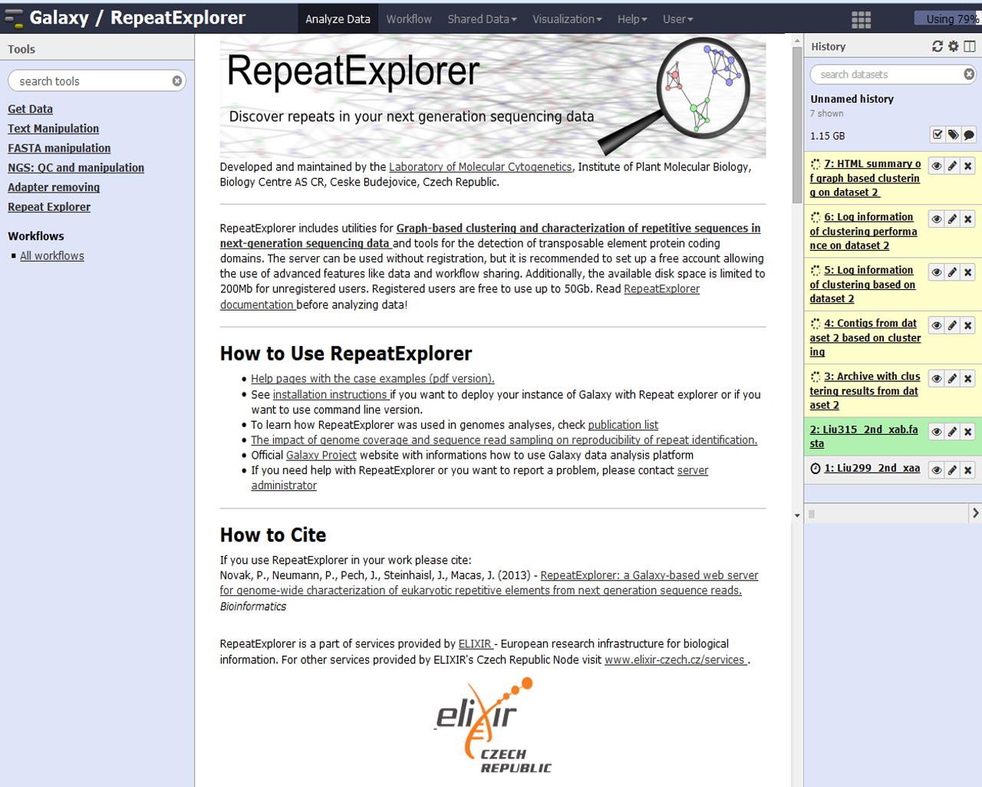
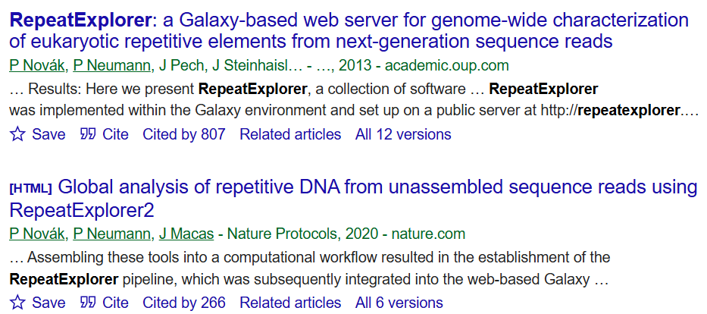
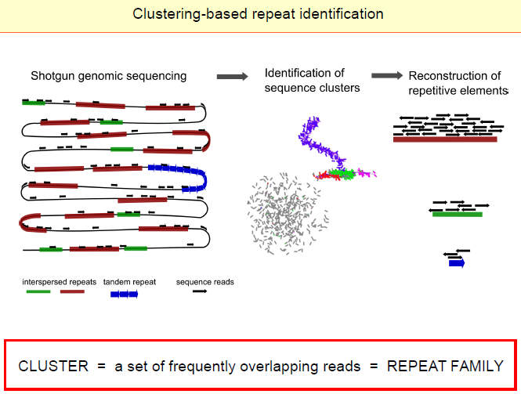
Graph-based clustering of sequences in
2 Gb to 10Gb of raw reads

Slide 11
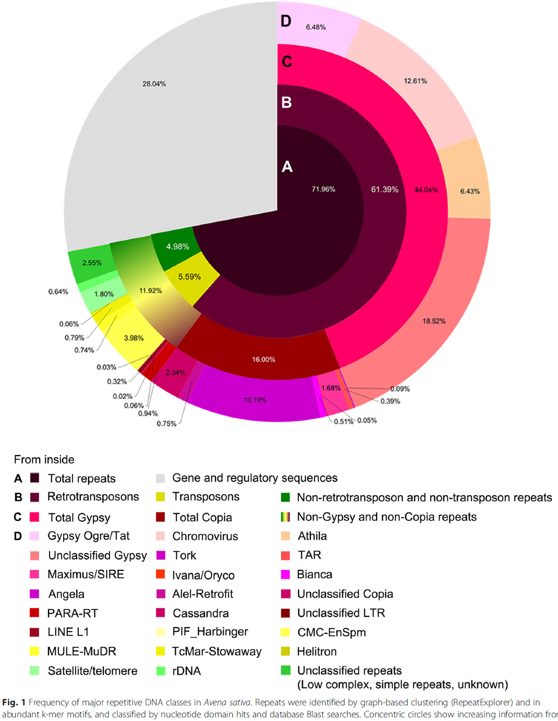

Slide 12
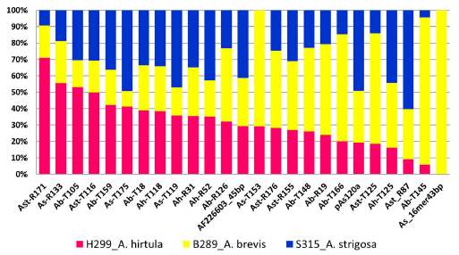
Three diploid Avena species
Relative abundance D-genome specific probes (RepeatExplorer cluster and k-mer assembly analyses) in three Avena genomes

Slide 13
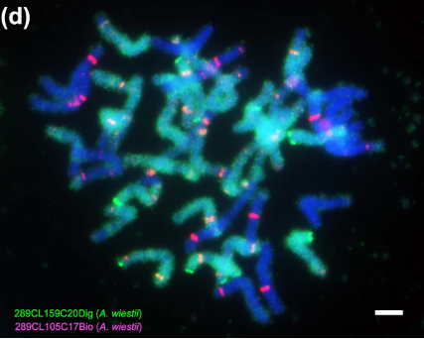
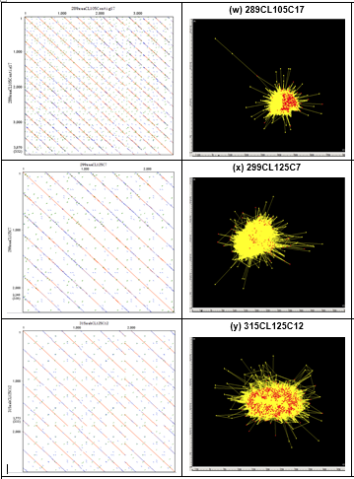
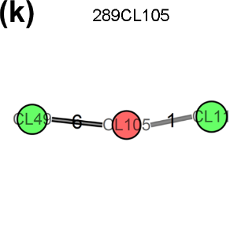
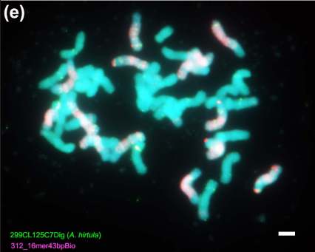
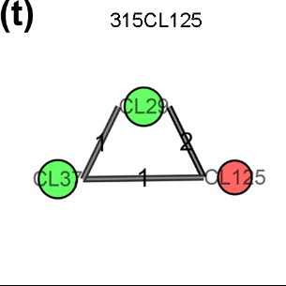
Probes labelling
C-, A- and D- genomes
Tandem probes
Neighborless cluster

Slide 14
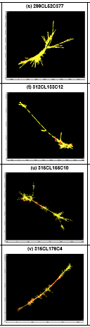
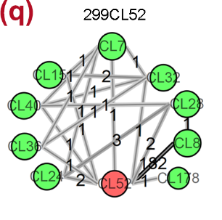
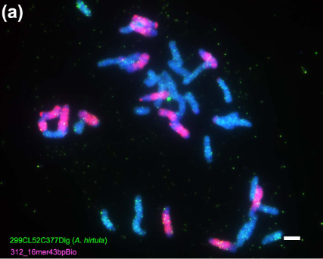
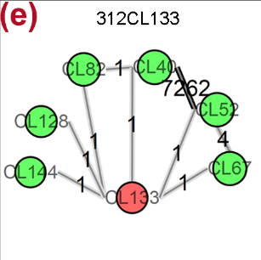
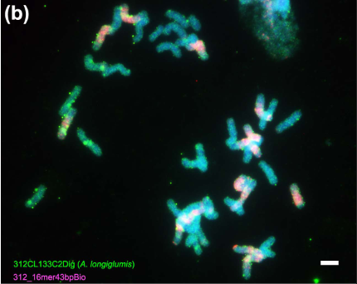
Probes labelling
C-, A- and D- genomes
Neighborless cluster
Retroelements
Neighborless cluster

Slide 15
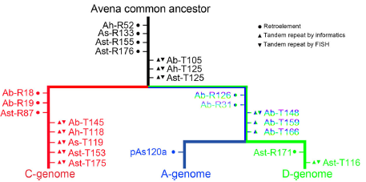

Slide 16
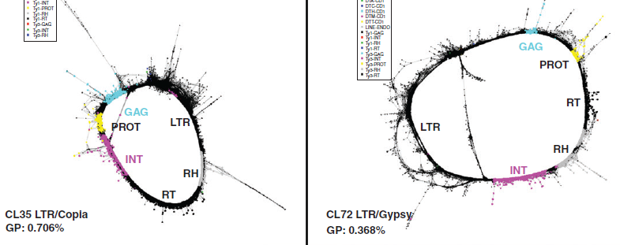
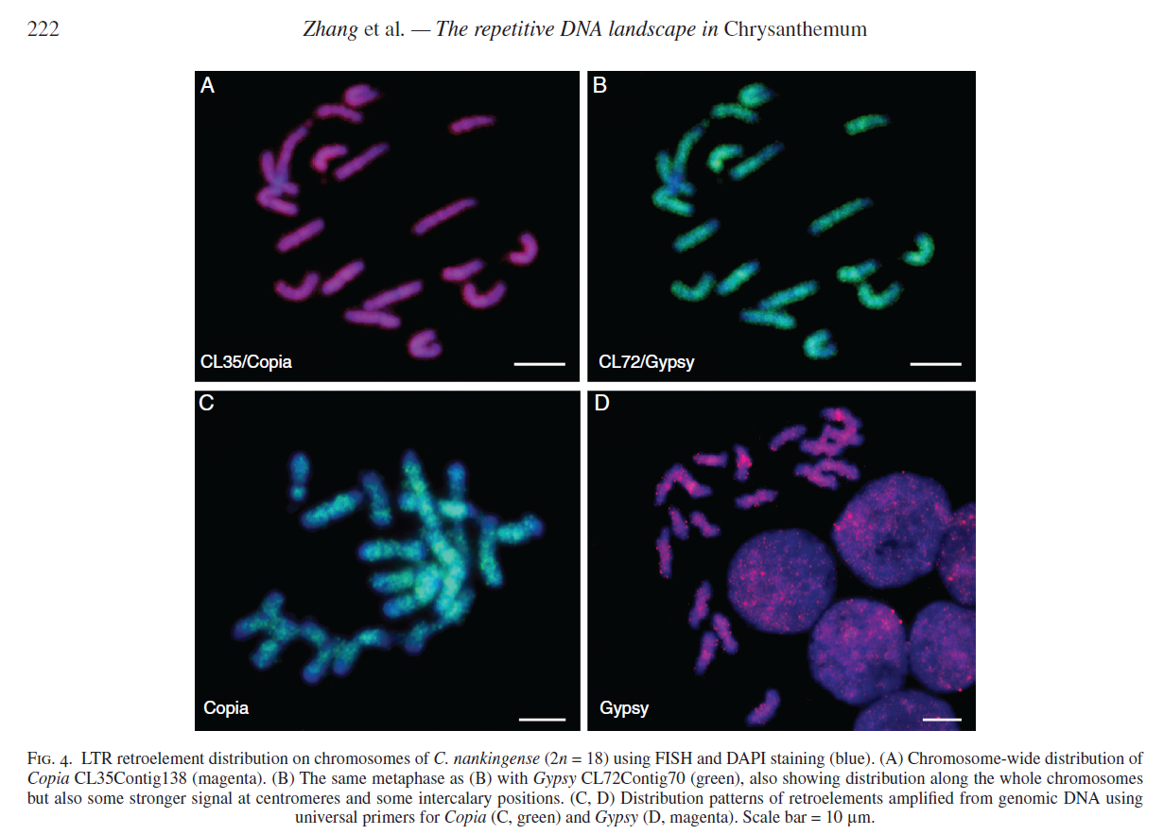

Slide 17
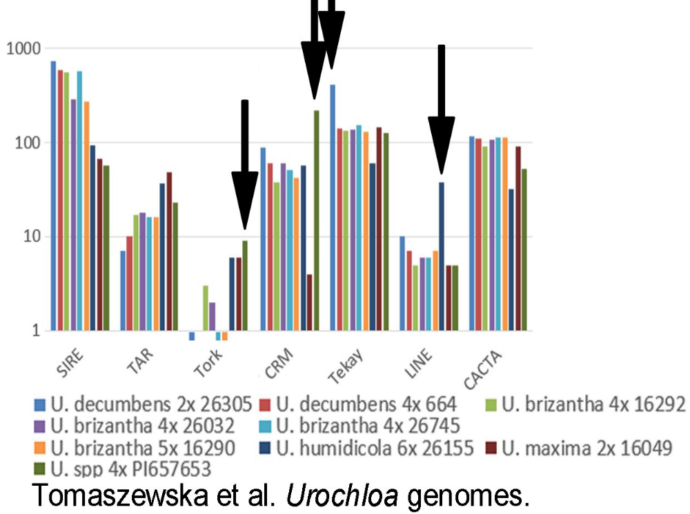
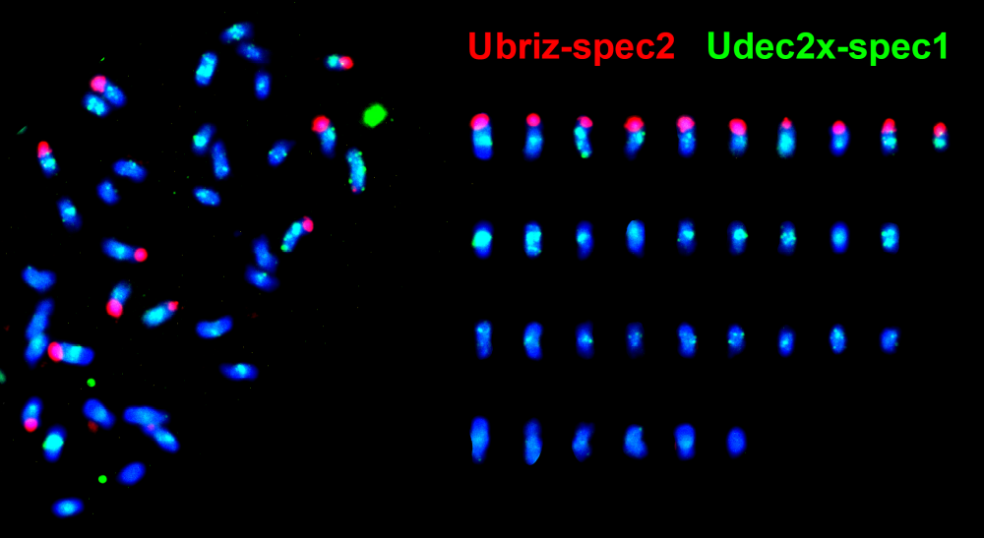
De novo identification of repeat families in Urochloa tropical forage grasses: DNA families that are amplified in some diploid genomes in polyploids
Abundance of repeat in sequence reads
Repetitive element
family

Slide 18
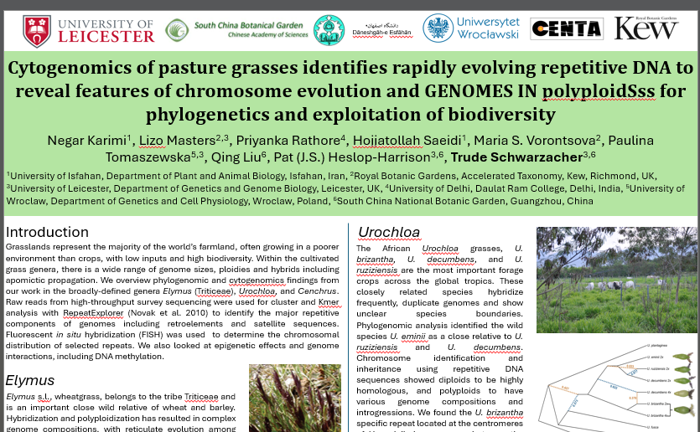

Slide 19
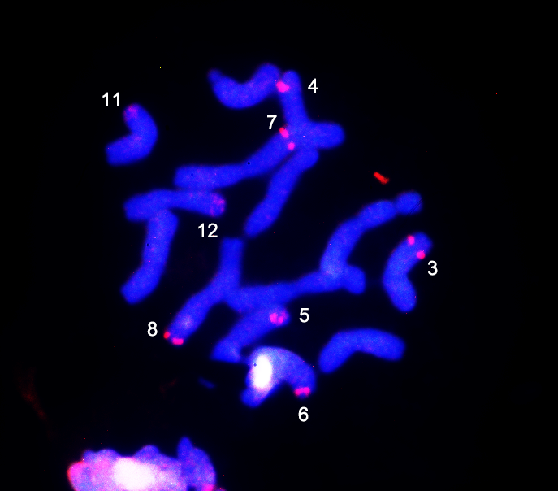
Massive oligonucleotide probe pools to identify chromosomes in diploid oats and potentially more widely
R41087Bio
  HongYu Yuan,
  Qing Liu, PHH
  Also assembly quality was verified
Notes:
The group adopted the optimized labeling strategy of a massive synthetic double-stranded oligonucleotide probe library, to construct the molecular karyotype of A. longilgumis, and realized the visualization of the intercalary regions and the pericentromeric regions. Hoping to make chromosome specific across Aveneae tribe and even into BOP clade

Slide 20
3.85 Gb chromosome assembly for genome evolution
  The diploid oat Avena longiglumis Qing Liu et al.
(b-e) Transposable element (TE) density. (f-j) Gene locations.
(k, l) Gene expression profiles.
Qing Liu et al. 2024. Chromosome-level genome assembly of the diploid oat species Avena longiglumis. Scientific Data.

Slide 21
Grass genome evolution
  Genome expansion in diploid grasses:
  from small, ancestral-type grasses (rice OS , Brachypodium BD) to Avena
Genome expansion in Avena is relatively uniform from telomere to sub-centromere
Not hypothesis of gene blocks interspersed with repeats and non-homologous terminal region
Qing Liu et al. Genome-wide expansion and reorganization during grass evolution: from 30 Mb chromosomes in rice and Brachypodium to 550 Mb in Avena. BMC Plant Biology 2023.
Notes:
Avena longiglumis 3.85 Gb, with 87% of all the repeats. Genome expansion from more ancestral smaller genomes like Oryza sativa 360Mbp and Brachypodium distachyon 270Mbp with chromosomal rearrangements from including nesting of chromosomes one inside another from x=12 to x=7. But most notably, away from centromeres, uniform expansion.

Slide 22
Grass genome evolution
  Genome expansion in diploid grasses:
  from small, ancestral-type grasses (rice OS , Brachypodium BD) to Avena
Notes:
Avena longiglumis 3.85 Gb, with 87% of all the repeats. Genome expansion from more ancestral smaller genomes like Oryza sativa 360Mbp and Brachypodium distachyon 270Mbp with chromosomal rearrangements from including nesting of chromosomes one inside another from x=12 to x=7. But most notably, away from centromeres, uniform expansion.

Slide 23
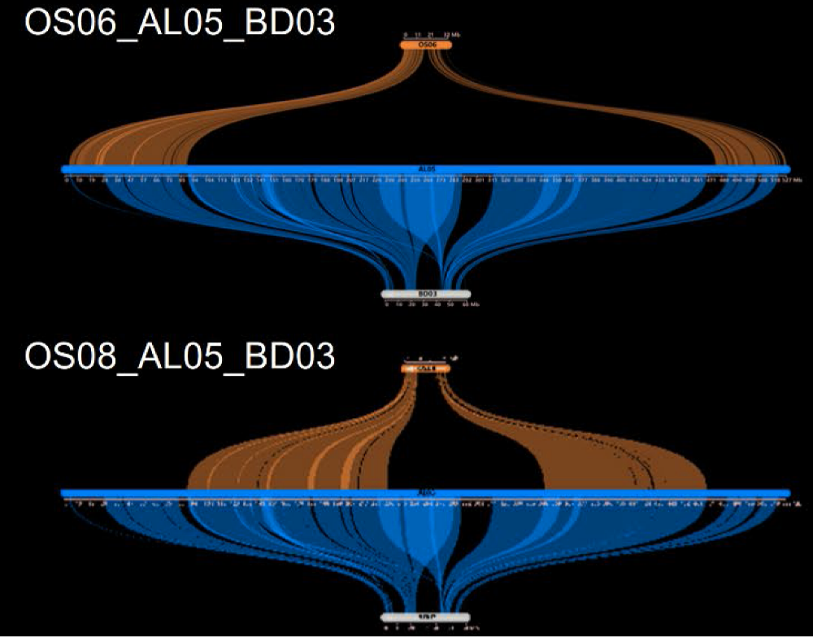
Grass genome evolution
  from ancestral-type grasses (rice OS , Brachypodium BD) to Avena ALO
Chromosomal evolution includes nesting as well as translocations
Notes:
Avena longiglumis 3.85 Gb, with 87% of all the repeats. Genome expansion from more ancestral smaller genomes like Oryza sativa 360Mbp and Brachypodium distachyon 270Mbp with chromosomal rearrangements from including nesting of chromosomes one inside another from x=12 to x=7. But most notably, away from centromeres, uniform expansion.

Slide 24
The Ancestral Grass Karyotype
  Qing Liu et al. BMC Plant Biology 2024
Notes:
We assembled a chromosome-scale genome sequences of the diploid oat Avena longiglumis, 3.85 Gb. Few genes near the centromeric regions but otherwise genes to near chromosome ends A. With 87% repeats, particularly expansion of copia and gypsy retrotransposable elements in B. Comparative study of syntenic blocks shows chromosomal rearrangements from rice and Brachypodium, to diploid Tribes Triticeae and Aveneae C. And identification of gene families D. Abbreviation as EVR research is just submitted, E-genomic expansion-V structural variation, R-chromosomal rearrangements.

Slide 25
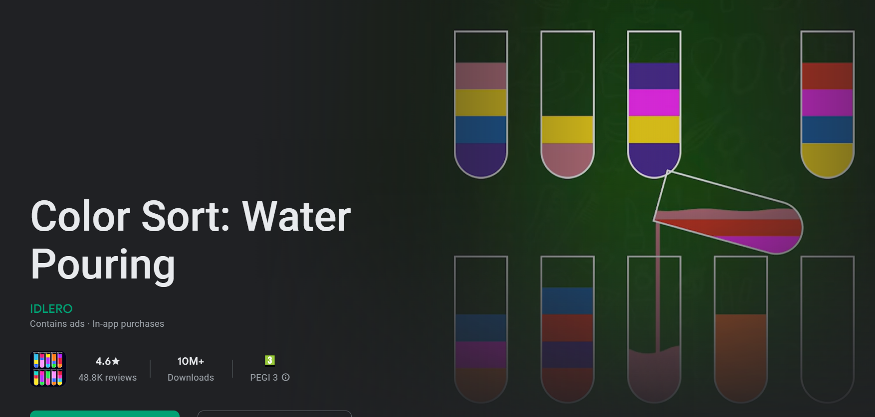
The Ancestral Grass Karyotype
  Qing Liu et al. BMC Plant Biology 2024
Notes:
We assembled a chromosome-scale genome sequences of the diploid oat Avena longiglumis, 3.85 Gb. Few genes near the centromeric regions but otherwise genes to near chromosome ends A. With 87% repeats, particularly expansion of copia and gypsy retrotransposable elements in B. Comparative study of syntenic blocks shows chromosomal rearrangements from rice and Brachypodium, to diploid Tribes Triticeae and Aveneae C. And identification of gene families D. Abbreviation as EVR research is just submitted, E-genomic expansion-V structural variation, R-chromosomal rearrangements.

Slide 26

Paulina Tomaszewska. Oat chromosome and
genome evolution defined by widespread
terminal intergenomic translocations in
polyploids. Frontiers Plant Science 2022
Paulina Tomaszewska. Avena eriantha x Avena sativa

Slide 27

Avena abyssinica
2n=4x=28 AABB genomes
Paulina Tomaszewska. Oat chromosome and genome evolution defined by widespread terminal intergenomic translocations in polyploids. Frontiers Plant Science 2022

Slide 28
Paulina Tomaszewska. Oat chromosome and
genome evolution defined by widespread
terminal intergenomic translocations in
polyploids. Frontiers Plant Science 2022

Slide 29

Evolutionary chromosome translocations
  Chromosome rearrangement in diploid Avena species
A. strigosa
A. longiglumis
A. eriantha
Multiple distal, inter-chromosome translocations occur during evolution of diploid species.
This is unlike wheat group (similar genome size)
Not like translocations in wheats (Triticeae):
Not hypothesis of a few whole-arm rearrangements
Also find similar distal inter-genomic translocations between chromosomes in derived hexaploid Avena
Notes:
We found another form of chromosome rearrangement occurs in Avena, contrasting with Triticeae wheats with similar large genome size. Avena comparative genomics shows terminal regions of about 20% of the arms including many genes exchange between chromosomes in species that have separated from common ancestors. Similarly-sized intergenomic translocations are seen in 6x hexaploid oat crop Avena sativa – now we know these happen in the diploids. In Triticeae, many fewer translocations and many are whole chromosome arms.

Slide 30

‘-’ = impossible; ‘nd’ = not detected
Paulina Tomaszewska. Oat chromosome and genome evolution defined by widespread
terminal intergenomic translocations in polyploids. Frontiers Plant Science 2022

Slide 31

Speciation via polyploidy
Chromosome number, genome size, repetitive DNA sequences, genes and regulatory sequences and their expression evolve following polyploidy – generating diversity and possible novel traits and enabling species diversification.
6x Avena sativa, oats, showing translocations & repetitive sequence homogenization in ancestral diploid genome (labelled orange, blue, green)
Heslop-Harrison JS, Schwarzacher T, Liu Q. 2023. Polyploidy: its consequences and enabling role in plant diversification and evolution. Annals of Botany 131: 1-10.
Notes:
So the results in diploid oats and banana family are showing genome rearrangements occurring during speciation – reliant on chromosomal and whole-chromosome-scale genome assemblies. Polyploidy is also important, and here we discuss evidence from a range of work from us and other groups of the role of polyploidy in speciation.

Slide 32




Slide 33


Slide 34


Slide 35


Slide 36
Convolutional Neural Networks detect local patterns and allow feature extraction
Transformers excel at modelling complex sequential data, capturing long-range dependencies

Slide 37


https://www.marktechpost.com/2025/08/30/c
https://www.marktechpost.com/2025/08/30

Slide 38
Future Plans: Foundational Large Language Models for Genomes
VISION: Decode the "Grammar" of Crop Genomes
  Develop a language-inspired, multi-modal foundational AI model to ‘explain’ genomes
APPROACHES:
  Tokens: Identify tokens with genomic meaning/function
  Convolutional Neural Networks (CNNs): Detect local patterns and perform feature extraction from genomic data.
  Transformers: Model complex sequential data, capture long-range dependencies across genomes, and identify cross-species patterns.

Slide 39

Feature | Tokens (AI/NLP) | k-mers (Genomics/Bioinformatics)
Primary Goal | Semantic Understanding. To capture meaningful units that convey function. | Pattern Identification. Systematically capture all possible substrings for sequence comparison, assembly, or finding motifs.
Method of Generation | Rule-based or learned. Identify motif boundaries, develop rules. | Simple; generic and universal for sequences.
Unit Size | Variable length. | Fixed length (k).
Meaning | Inherent and annotation applied. The tokens “ATG" or “TTTAGGG” (sometimes) have a learned semantic meaning. | None: annotation applied.
Overlap | Non-overlapping but lossless. (Exceptions for sub-tokenization like BPE and ? Transformers). | Overlapping by design. No structural information lost.
Domain | Natural Language – can it discover the “genomic language”? | Assembled genomes; Short or long read high volume sequences (DNA, RNA).
k-mers
Tokens
(Below table: The nature and genomic landscape of repetitive DNA classes Fengjiao Zhang 2023)

Slide 40
Future Plans: Foundational Large Language Models for Genomes
VISION: Decode the "Grammar" of Crop Genomes
  Develop robust models to pinpoint critical genes, structural variants, and gene regulators across diverse crop species.
  Identify unexpected genetic interactions and address the challenge of “missing heritability.”

Slide 41



Exploit positive (avoid negative) epistatic & pleiotropic interactions plant breeding
Developing avenues of artiﬁcial intelligence, novel exploitation of large-scale genomics & phenomics data
Find genes with minor effects to analyse epistatic interactions and pleiotropic QTLs accounting for missing heritability

Slide 42





Slide 43


The Rhizosphere and Microbiome In press Trends in Plant Science April 2025

Slide 44
Future Plans: Foundational Large Language Models for Crop Plant Genomes
VISION Decode the "Grammar" of Crop Genomes
  Develop a language-inspired, multi-modal foundational AI model to ‘explain’ genomes
  Identify key genomic features, track evolutionary changes: link phenotype to genotype.
Expected Outcomes & Impact
  Elucidate complex interactions between organisms, their environment, and disease (biotic/abiotic stresses).
  Identify traits such as disease resistance and climate resilience.
  Provide data-driven recommendations for biodiversity conservation efforts.
  Facilitate precise breeding for developing crops with a reduced environmental footprint.

Slide 45
Cytogenomics of oats (Avena): genome evolution in action
Pat Heslop-Harrison,
Trude Schwarzacher,
Paulina Tomaszewska, Qing Liu
University of Leicester, Institute for Environmental Futures
South China Botanical Garden, Guangzhou, China,
University of Wroclaw, Wroclaw, Poland

Slide 46
What has farming and agriculture done
Food
Feed (Forage)
Fuel
Fibre
Feedstock
Flowers (Fun)
Pharmaceuticals
The Seven F’s of Farming

Slide 47



Sequence alignment of contigs to
complete sequences of rDNA of oat
6 loci of 45S rDNA
14 loci of 5S rDNA

Slide 48
Cytogenomics of oat (Avena) genome evolution: Intra- and inter-genomic chromosomal translocations, repetitive DNA dynamics, and reconstruction of ancestral grass karyotypes show genome evolution in action
Chromosome-scale genome assemblies, sequence reads, and fluorescence in situ hybridization (FISH) of Avena species reveal key evolutionary mechanisms in the Aveneae tribe, complementing and often contrasting with the Triticeae wheats. We demonstrate how Avena's 10-15-fold genome expansion from rice/Brachypodium enables visualization of the ancestral grass karyotype, with uniform chromosome arm size expansion, conserved synteny, repetitive DNA divergence with homogenization, and chromosomal rearrangements including nesting. Notably, Avena diploid and polyploid species show large (>50Mb) distal translocations during evolution, contrasting with fewer, often centromeric translocations in wheat. Avena polyploids exhibit frequent distal intergenomic exchanges, mapped in tetraploids, hexaploids (AACCDD), and octoploids using repetitive probes and in genome assemblies. Repetitive DNA, comprising some 80% of the genome (dominated by Ty3/Gypsy retroelements), shows constrained family amplification and genome-specific homogenization, driving sequence evolution. Structural variation is critical to characterize, and the patterns have implications for both speciation in Aveneae and the ways the biodiversity in the Tribe can be exploited in breeding, through targeted strategies for introgressing wild Avena traits into hexaploid oats.
We are grateful to our co-authors and collaborators; further information and references are at www.molcyt.org

Slide 49
Here, we aimed to perform a comprehensive genome-wide identification and characterization of the lectin receptor-like kinase (LecRLK) gene family in Avena sativa (oat), with a focus on elucidating their potential roles in salt stress tolerance. Specifically, this study aimed to identify LecRLK gene family members and analyze their gene structures, conserved domains, and phylogenetic relationships. Additionally, utilizing transcriptomic data, we investigated the expression profiles of these genes under salt stress conditions

Slide 50
Poster 7. Endogenous pararetroviruses in tomatoes and their hybrids: Exploring their role from silencing to subgenome regulation. Nicola Schmidt1, Tony Heitkam1, Trude Schwarzacher2, Pat Heslop-Harrison2, Sara Lopez-Gomollon
Poster 9. Cytogenomics of pasture grasses identifies rapidly evolving repetitive DNA to reveal features of chromosome evolution and polyploidy for phylogenetics and exploitation of biodiversity. Negar Karimi1, Lizo Masters2,3, Priyanka Rathore4, Hojjatollah Saeidi1, Maria Vorontsova2, Paulina Tomaszewska5,3, Qing Liu6, Pat (J.S.) Heslop-Harrison3,6, Trude Schwarzacher3,6
Poster 17. The repetitive DNA sequence landscape in Epipactis: Chromosome and genome evolution defined by major repeat classes.Paulina Tomaszewska1, Natalia Szymczak1, Trude Schwarzacher2, Elzbieta Zolubak-Szczypiorska3, Pat Heslop-Harrison2, Anna Jakubska-Busse3

Slide 51
Cytogenomics = Genome Evolution = Plant & Animal Breeding = Agriculture
Reconstructing the past
→ Engineering the future
The study of chromosomes
  Illuminates the past
  Shows the future
  Maps and offers directed tools to shape agriculture

Slide 52


Slide 53

Probes labelling C-, A- and D-genomes

