Slide 1
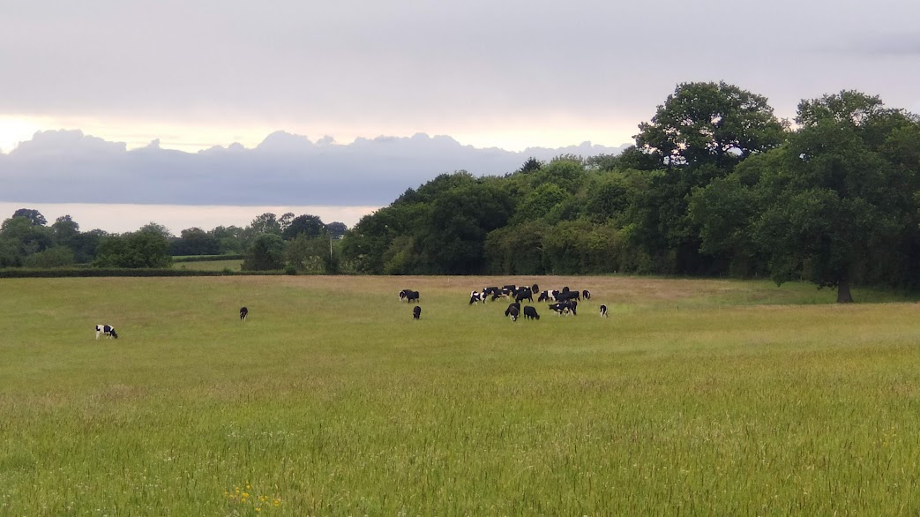


What cytogenomics has, is and will do for agriculture in our world
Plant molecular cytogenetics
Pat Heslop-Harrison
phh@molcyt.com
www.molcyt.org
Nîmes ECA Course
29 March 2026
A flavour of the tricks our species show and how we study them
Animal, Plant and Comparative Cytogenomics

Slide 2
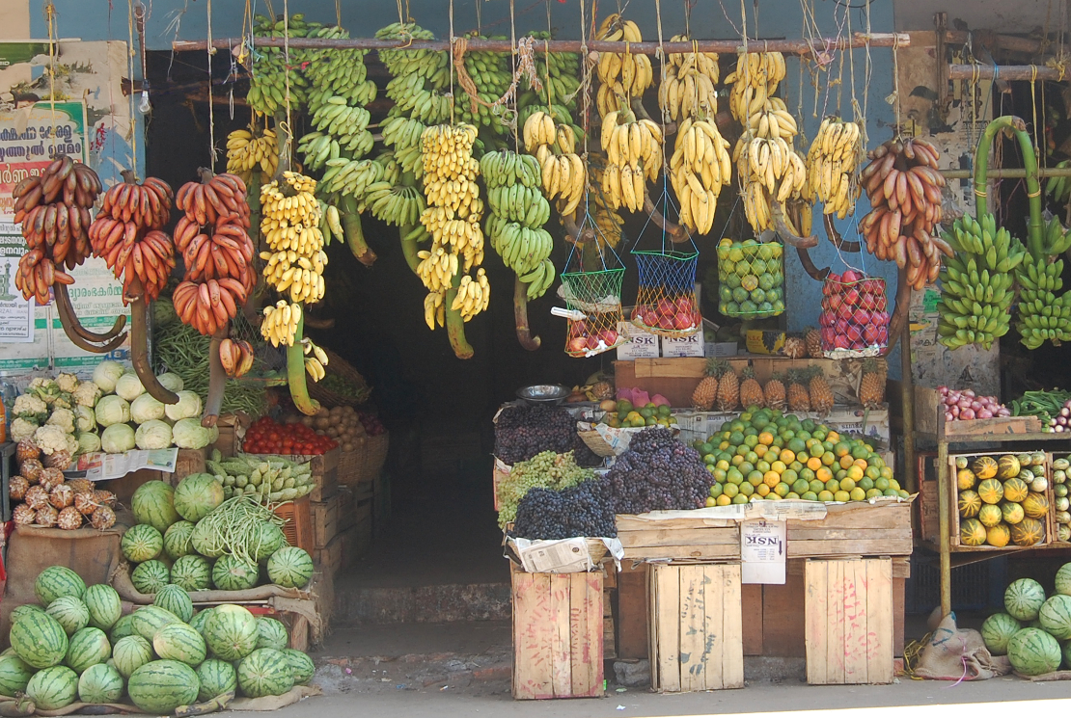
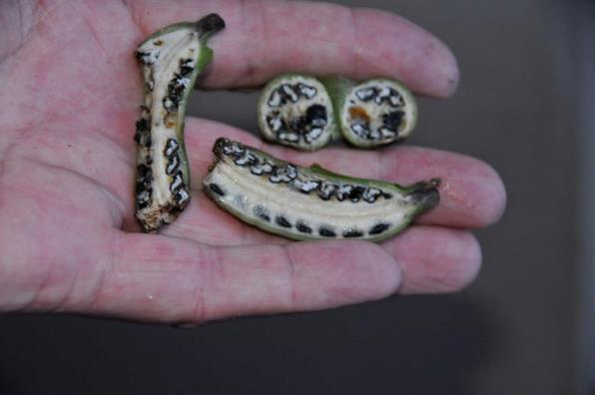
Diversity in sterile cultivars
Wild diploid banana with seeds

Slide 3
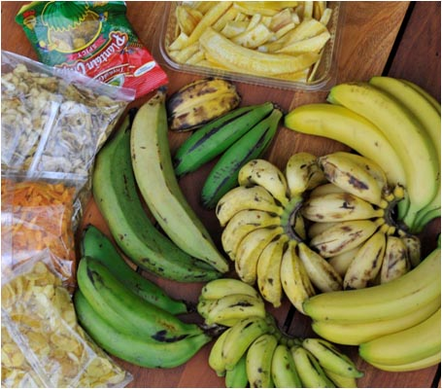
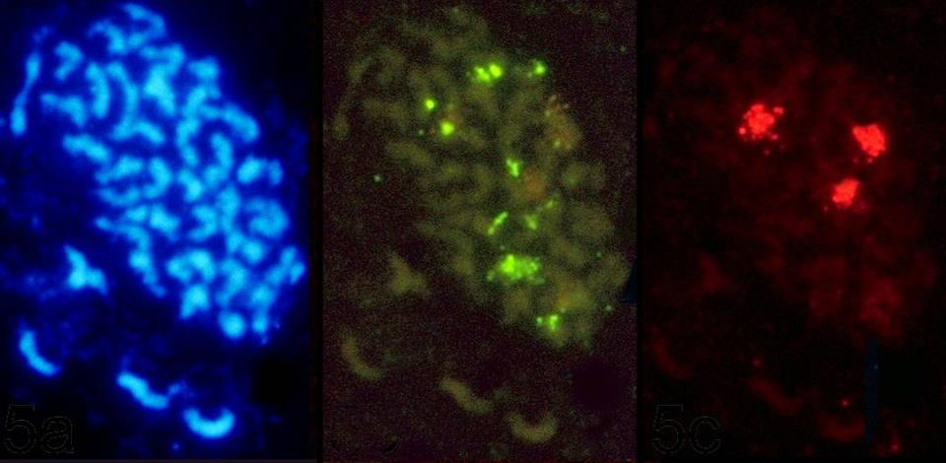
Cavendish : the most common dessert banana cultivar
2n=3x=33; AAA genomes
Musa Sequence: d’Hont, HH et al. Ensete: Wang, HH et al 2022

Slide 4
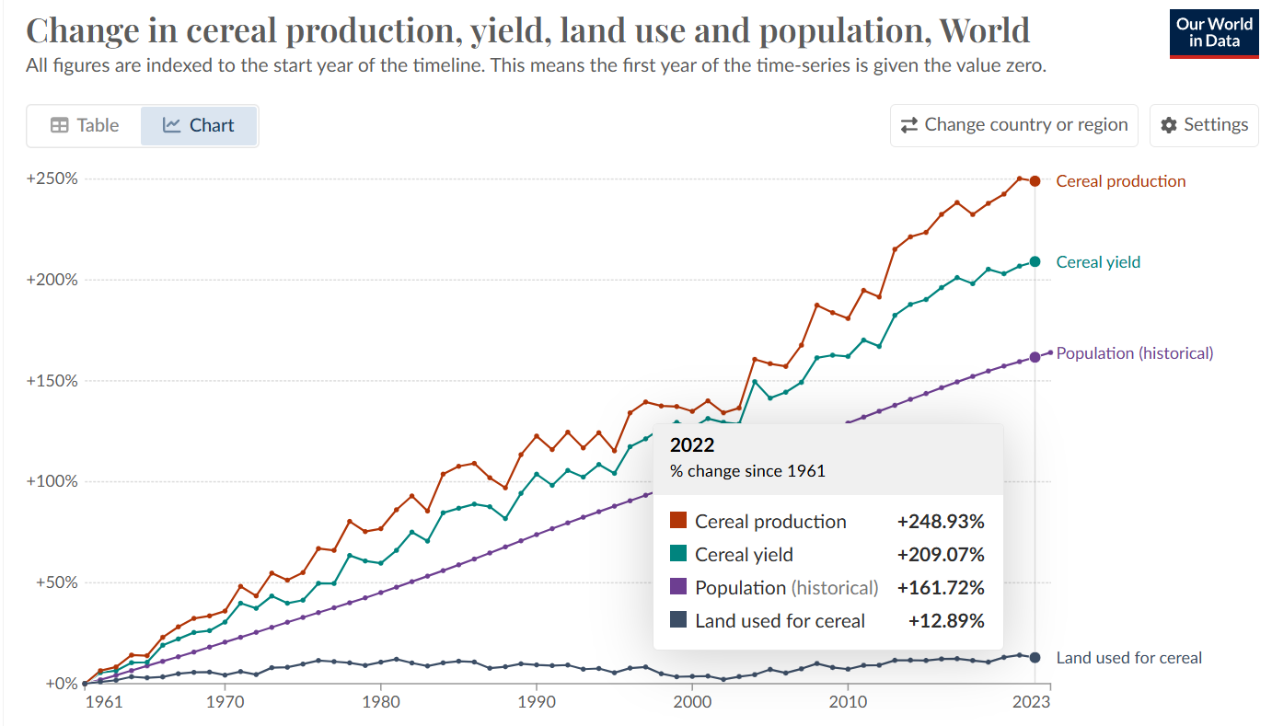
c. 1% a year increase in yield
across all crops
for the last 60 years
Raw data from FAOSTAT

Slide 5
Cytogenomics = Genome Evolution = Plant & Animal Breeding = Agriculture
Reconstructing the past
→ Engineering the future
The study of chromosomes
  Illuminates the past
  Shows the future
  Maps and offers directed tools to shape agriculture

Slide 6
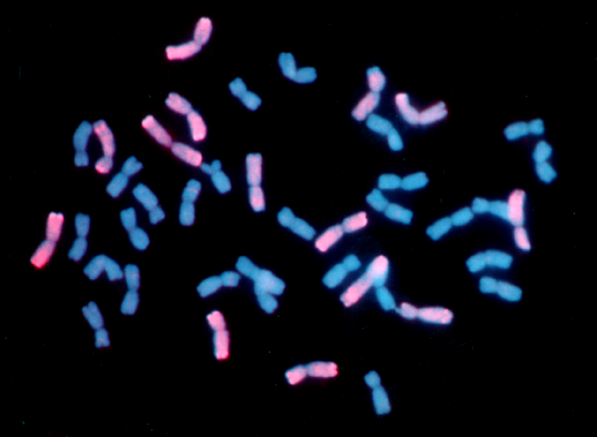
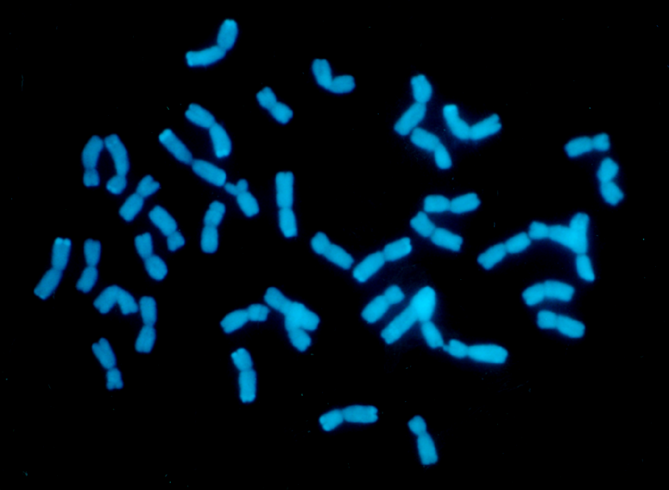
Triticale: wheat x rye hybrid
A polyploid
AABB wheat x RR rye
2n=6x=42
Genome size
17,000 Mbp

Slide 7
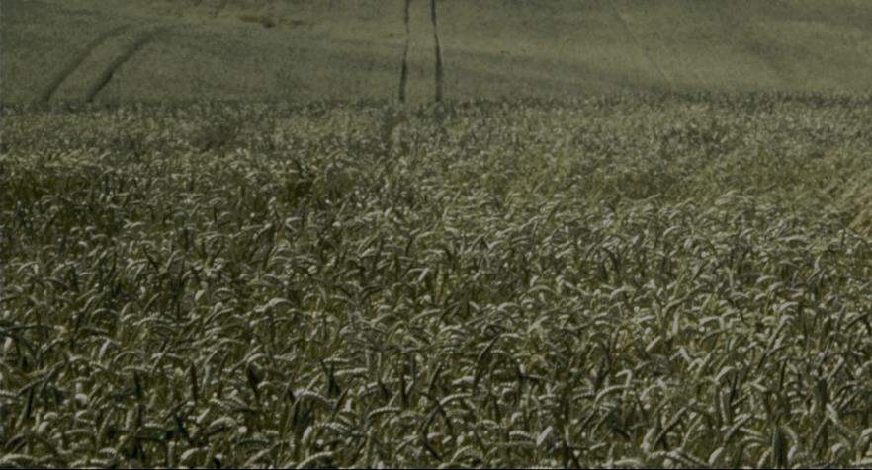
Wheat evolution and polyploidy
Triticum uratu
2n=2x=14
AA
Aegilops speltoides
relative
2n=2x=14
BB
Triticum tauschii
(Aegilops squarrosa)
2n=2x=14
DD
Triticum dicoccoides
2n=4x=28
AABB
Einkorn
Triticum monococcum
2n=2x=14
AA
Bread wheat
Triticum aestivum
2n=6x=42
AABBDD
Rye
Secale cereale
2n=2x=14
RR
Durum/Spaghetti
Triticum turgidum ssp durum
2n=4x=28
AABB
Triticale
xTriticosecale
2n=6x=42
AABBRR

Slide 8
Polyploid species
A species with more than two complete chromosome sets
Each set designated A, B…
More than two homologous chromosomes
  Diploid: 2x, AA – NOT a polyploid
  Triploid: 3x, AAA – polyploid (eg desert banana)
  Tetraploid: 4x, AAAA – autopolyploid
  Tetraploid: 4x, AABB – allopolyploid with 2 ancestors
At meiosis: often see Multivalent formation
  2 chrs: bivalent; 3 chrs trivalent; 4 chrs quadrivalent
Also WGD – Whole Genome Duplication and
Palaeopolyploidy

Slide 9
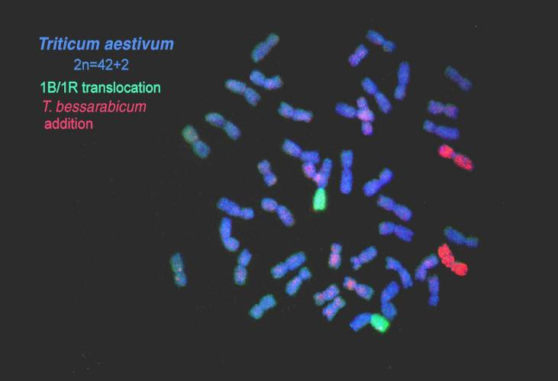
Genomes in sexual hybrids
Alien chromosome introgression
Introgression through hybrids followed by backcrossing to wheat, transferring chromosomes and recombining chromosome segments.

Slide 10
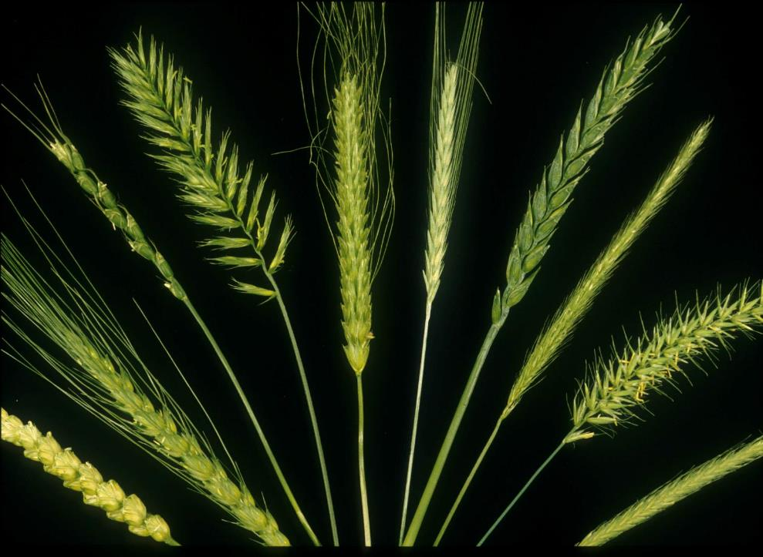
Cytogeneticists: Trying to stop diseases not through crop protection chemicals (drugs) but using genetic resistance to fungi, bacteria, insects and viruses from ‘wild’ species, as well as by improved agronomy

Slide 11
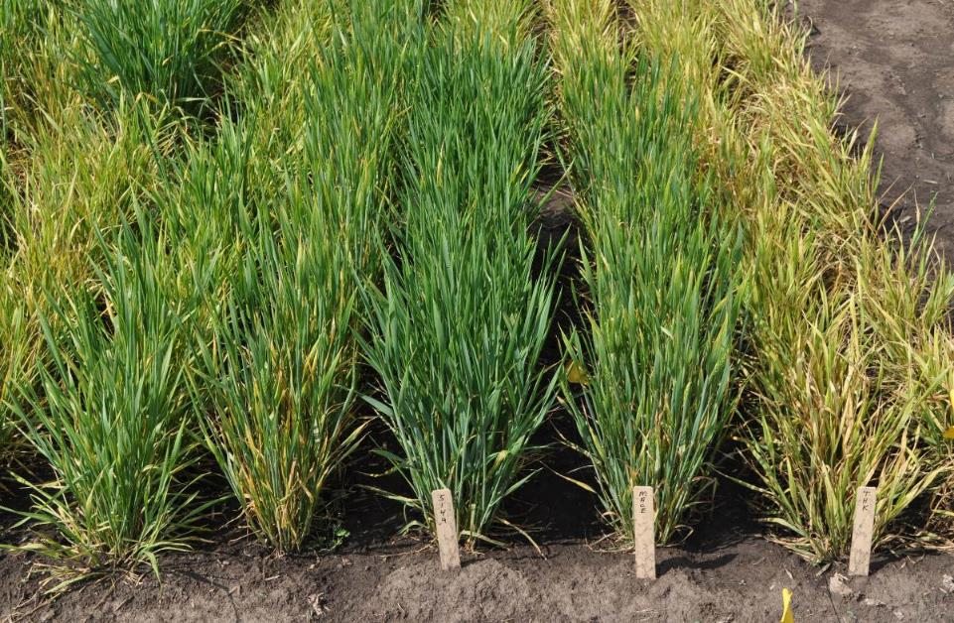
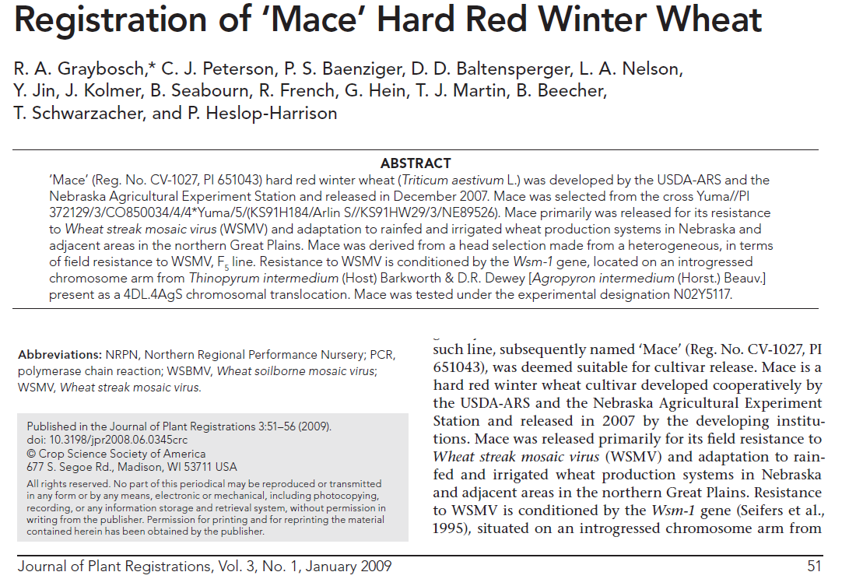

Wheat Streak Mosaic Virus resistance
From Thinopyrum sp in wheat
N02Y5149 Mace Tomahawk
Resistant Th&R Resistant Th Control

Slide 12
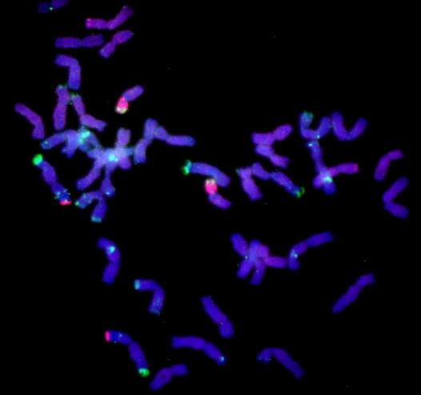






4D T4DL*4Ai#2S
DAPI Afa Thin all
(blue) (green) (red)
1B
1B recombinant
BPI and BPII
T1BL*1RS
BP III
Th. intermedium DNA
pSc119.2/CS13
Thin (red)
5S (green)
Thin (red)
5S 45S 119.2
(green)
Th. intermedium
(Thin)
rye
Heterochromatin
(hybridizes with genomic rye and
Th. intermedium DNA
Thin (red)
119.2 (green)
45S (red)
pSc119.2 (green)
dpTa1/Afa
pSc119.2/variable between lines
5S rDNA
Niaz Ali et al
45S rDNA

Slide 13
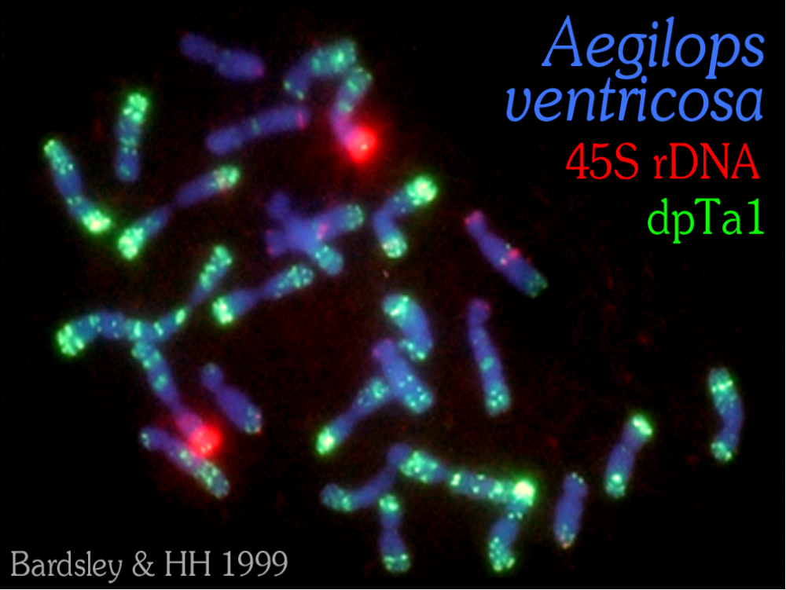
Notes:
Patg Heslop-Harrison www.molcyt.com
13

Slide 14
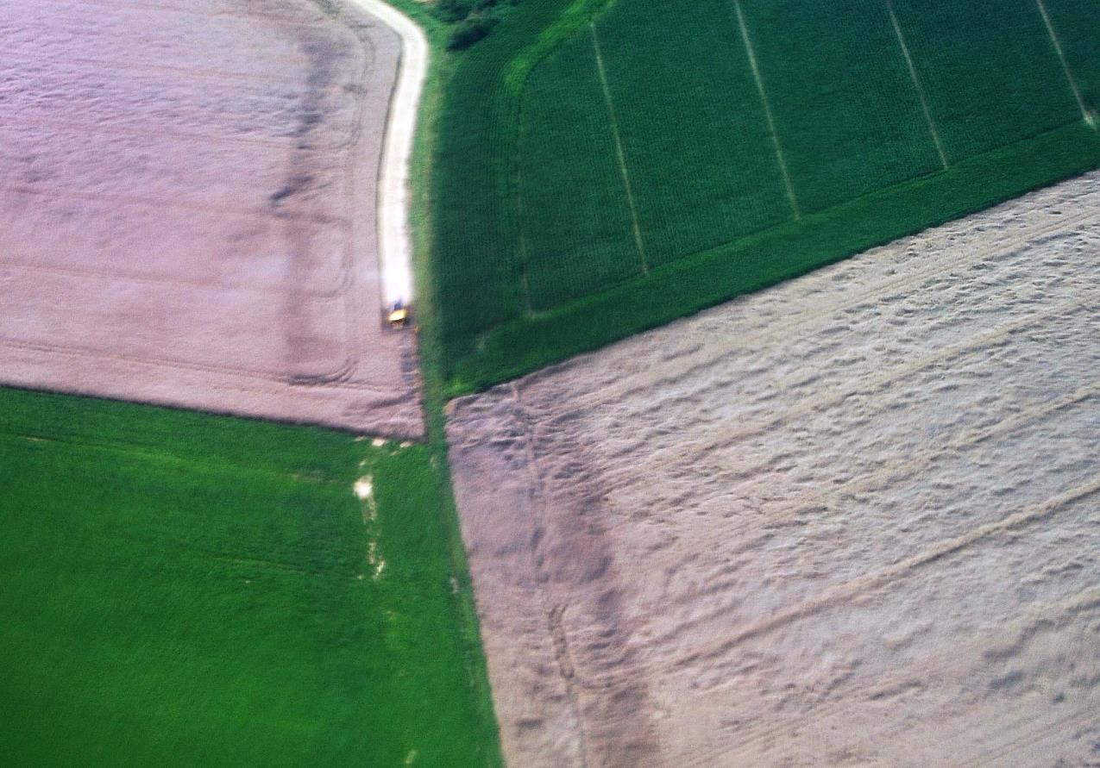
Lodging in cereals UK
Notes:
Patg Heslop-Harrison www.molcyt.com
14

Slide 15
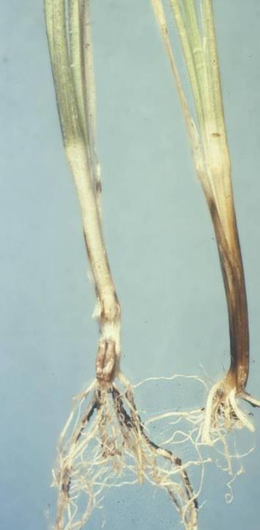
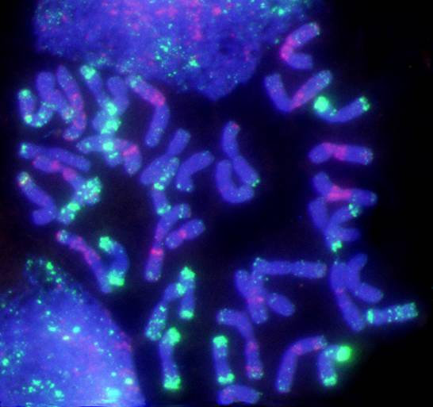
Notes:
Patg Heslop-Harrison www.molcyt.com
15

Slide 16
Aegilops ventricosa
DDNN
×
Triticum persicum Ac.1510
AABB
Inheritance of Chromosome 5D
ABDN
AABBDDNN
×
Marne
AABBDD
VPM1
×
Hobbit
Dwarf A
CWW1176-4
×
Virtue
Rendezvous
×
{Kraka × (Huntsman × Fruhgold)}
Piko
96ST61
dpTa1
Notes:
Patg Heslop-Harrison www.molcyt.com
16
18

Slide 17
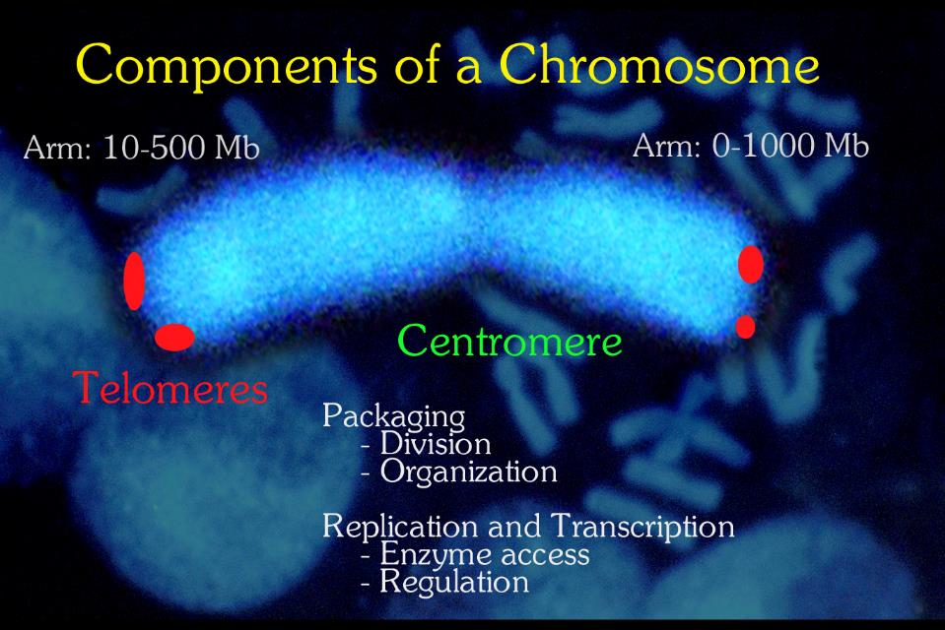
Genes

Slide 18
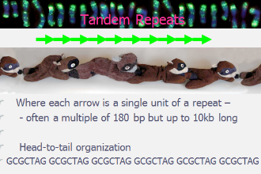
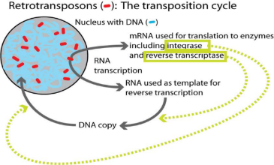
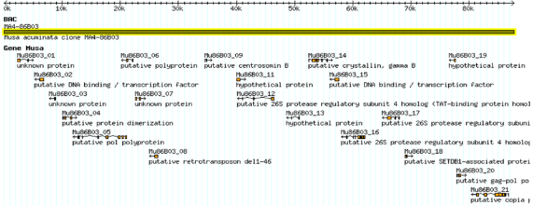
Major Genomic Components
Typical Fraction
10%
5%
10%
15%
50%
10%
Tandem Repeats
Simple Sequence Repeats
Dispersed Repeats
Functional Repeats
Transposable Elements
Genes

Slide 19
Organelle sequences
from chloroplasts or
mitochondria
Nuclear
Genome
Genes, regulatory and non-coding low-copy sequences
Sequences from viruses
Transgenes introduced with molecular biology methods
Repetitive DNA sequences
45S and 5S rRNA genes
Other genes
Tandem repeats
Satellite sequences
Repeated genes
Dispersed repeats
Simple sequence repeats or microsatellites
Transposable elements
Blocks of tandem repeats at discrete chromosomal loci
Structural components of chromosomes
Retrotransposons
DNA transposons
Dispersed repeats that we don’t know about – except each is significant proportion of genome
Autonomous/ non-autonomous
Subtelomeric repeats
Centromeric repeats
Telomeric repeats
DNA sequence components of the nuclear genome
After Biscotti et al. Chromosome Research 2015

Slide 20
Wheat evolution and polyploidy
Triticum uratu
2n=2x=14
AA
Aegilops speltoides
relative
2n=2x=14
BB
Triticum tauschii
(Aegilops squarrosa)
2n=2x=14
DD
Triticum dicoccoides
2n=4x=28
AABB
Einkorn
Triticum monococcum
2n=2x=14
AA
Bread wheat
Triticum aestivum
2n=6x=42
AABBDD
Rye
Secale cereale
2n=2x=14
RR
Durum/Spaghetti
Triticum turgidum ssp durum
2n=4x=28
AABB
Triticale
xTriticosecale
2n=6x=42
AABBRR

Slide 21
susp. strangulata
IRAP
SSR
Cross-pollinating
ancestor
FISH
var. meyeri
var. anathera
subsp. tauschii
Self-pollinating ancestor
(Aegilops tauschii)
var. tauschii
An evolutionary model supported by molecular analyses
Saeidi , HH et al. 2010
Notes:
21

Slide 22
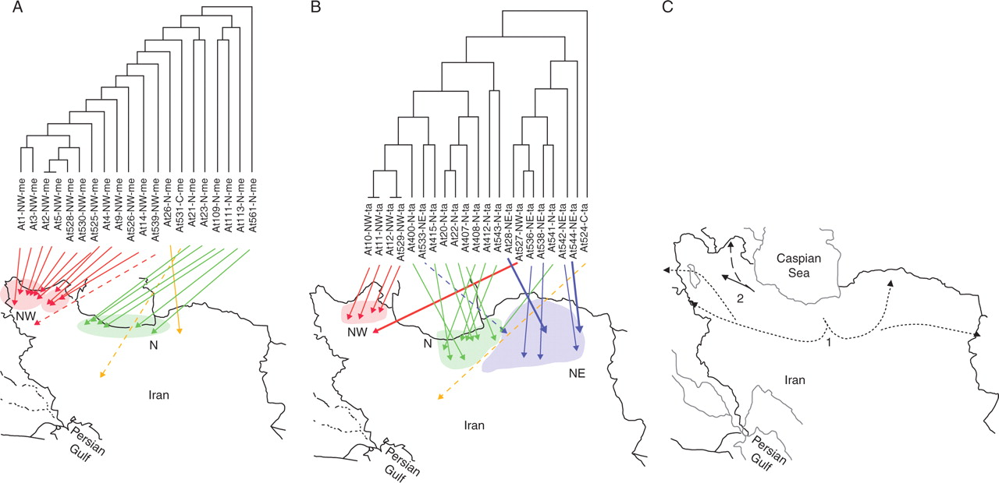
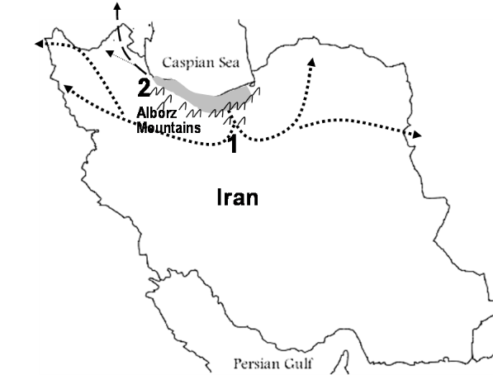
Relationships (UPGMA IRAP) accessions of Aegilops tauschii subspecies separated by repetitive sequences
Phylogeography:
Distribution over short geographic distances
Species originated from North of Iran and distributed in two directions
tauschii genotype passes from middle parts of Alborz Mountains and the distributed eastward and westward (direction 1)
strangulata genotype are distributed along the Caspian Sea shore (direction 2)
Saeidi, H. et al. Ann Bot 2008 101:855-861; doi:10.1093/aob/mcn042

Slide 23
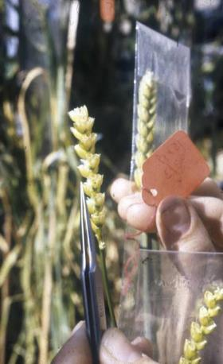
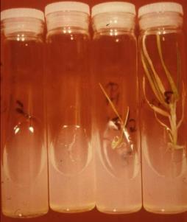
Breeding strategies: introduce chromosome segments with desirable genes from alien species by crossing and backcrossing
AABBDD x RR
ABDR
Double chromosomes
AABBDDRR (octoploid – 2n=8x=56)
Backcross to wheat
Looses the R chromosomes eventually
AABBDD+1R
Induce recombination
AABBDD including 1BL/1RS

Slide 24
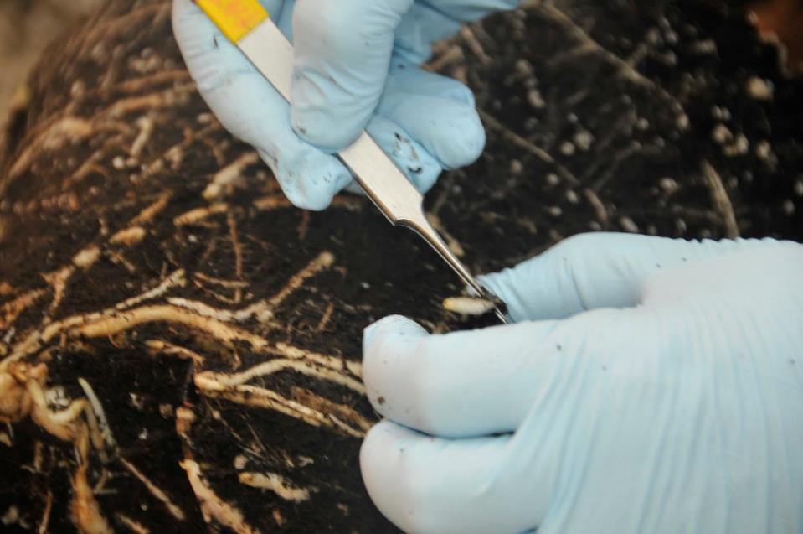
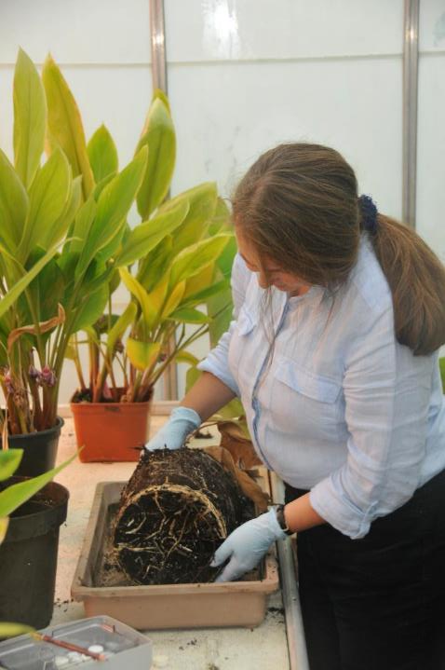
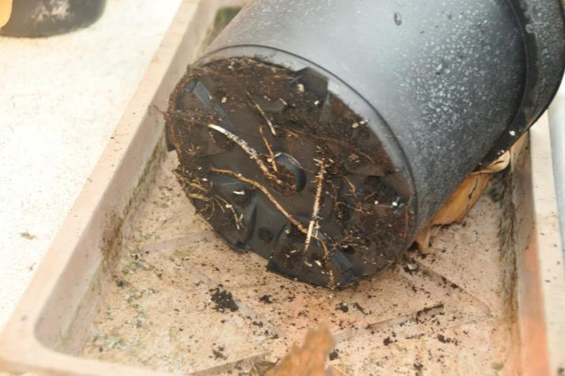
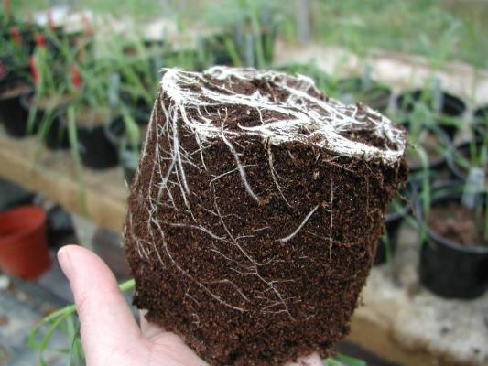

Slide 25
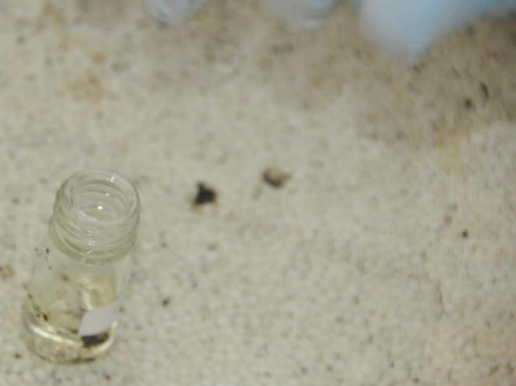
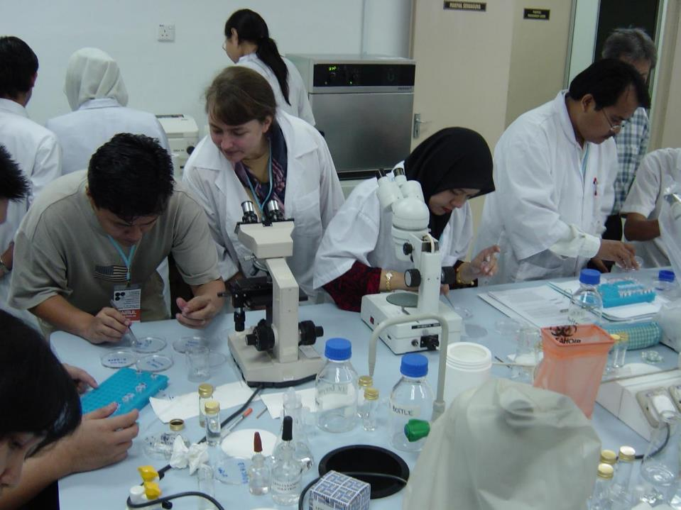


Slide 26
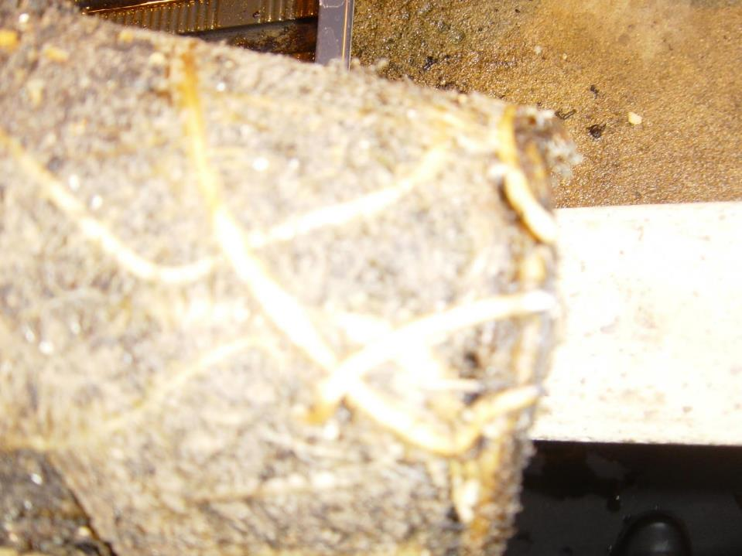
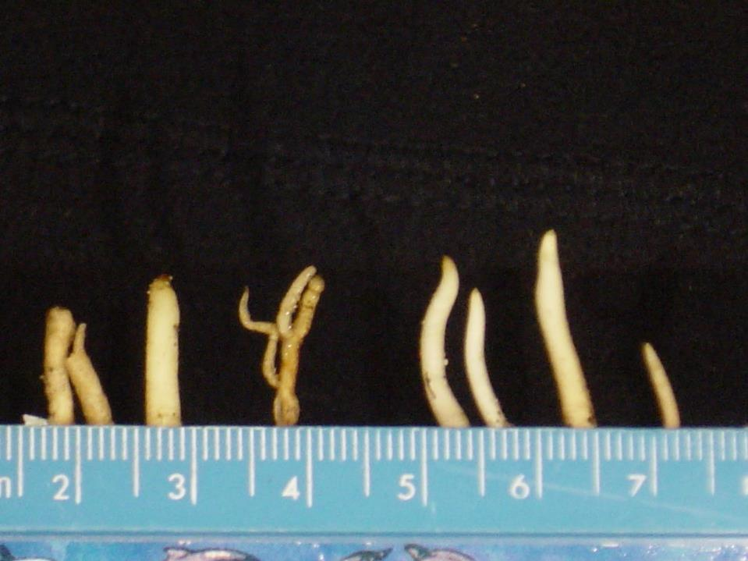
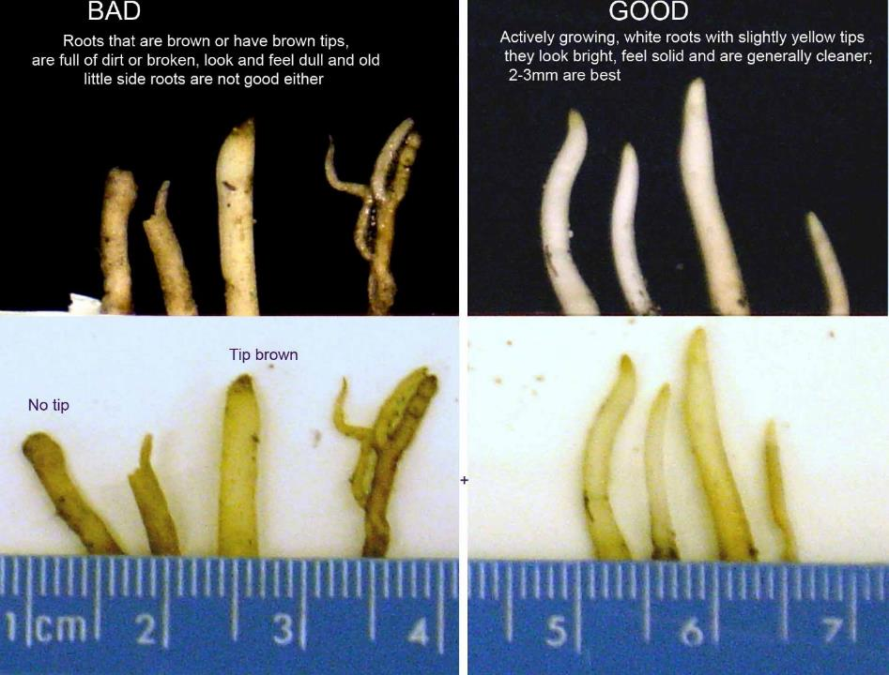
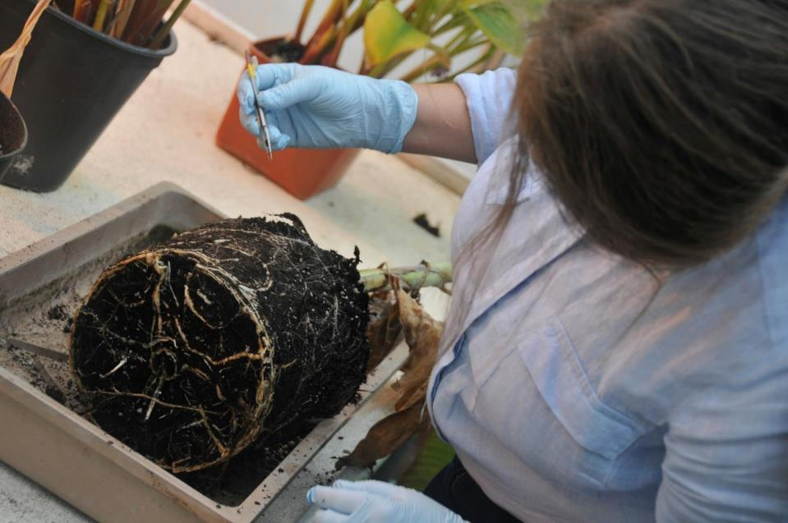
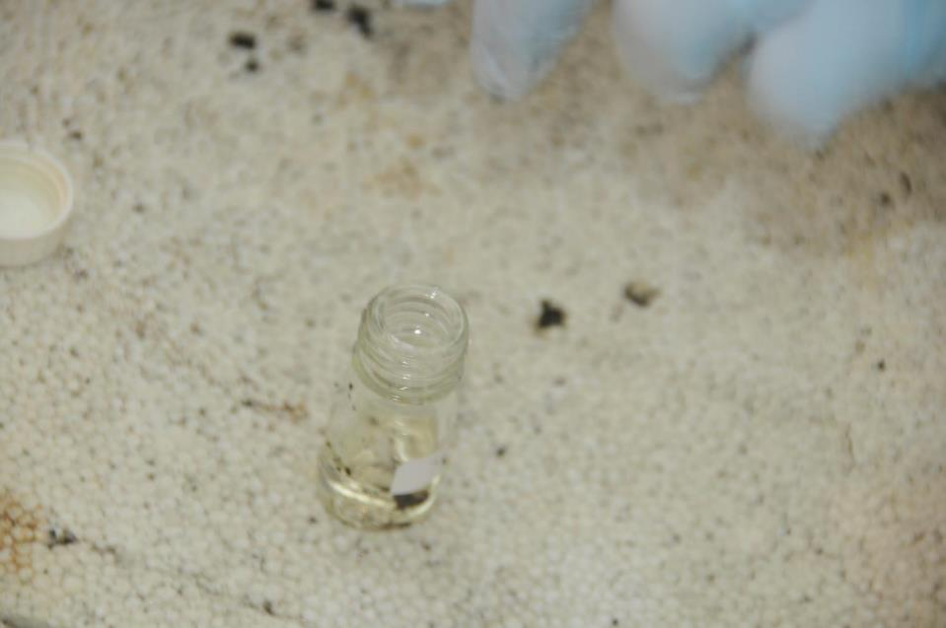

Slide 27
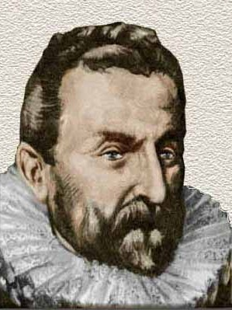
Nîmes …
famous for …
Nîmes most famous son
Gravure publiée par l'éditeur
Albin Michel - Public Domain

Slide 28
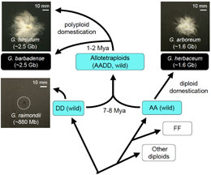
2n = 4x = 52
Nîmes …
famous for …
Serge de Nîmes
2n = 2x = 26
https://sites.cns.utexas.edu/cottongenomics/cotton
Nîmes most famous son
1530 – 1600
Jean Nicot
Ambassador in Lisbon
First French dictionary

Slide 29
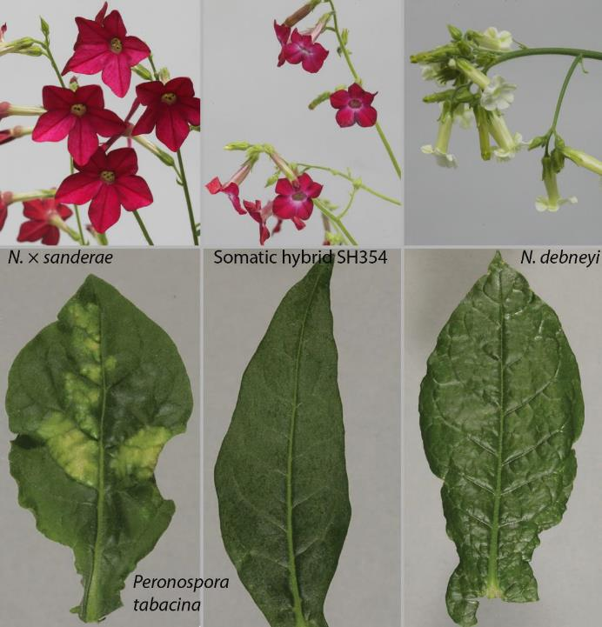
Instead of crossing Another way to transfer genes: CELL (protoplast) FUSION in vitro
Cell fusion
hybrid of two
4x tetraploid
tobacco
species
Patel, Badakshi, HH, Davey et al 2011 Annals of Botany

Slide 30
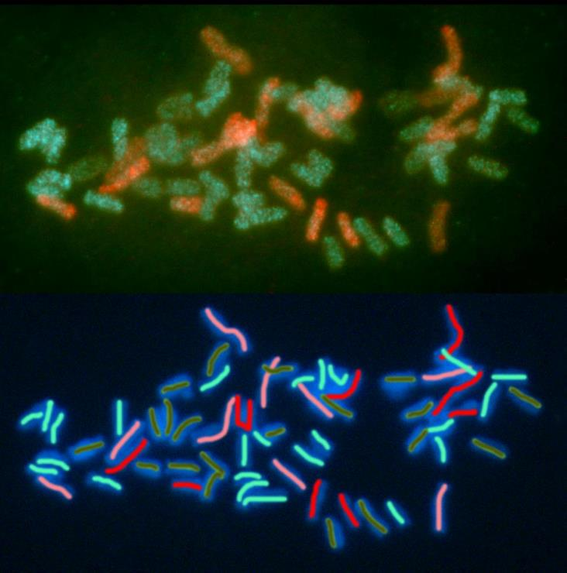
Nicotiana hybrid
4x + 4x cell fusions
Each of 4 chromosome sets has distinctive repetitive
DNA when probed with genomic DNA
Farah Badakshi
Somatic hybrid plants of
Nicotiana × sanderae (+)
N. debneyi with fungal
resistance to Peronospora

Slide 31
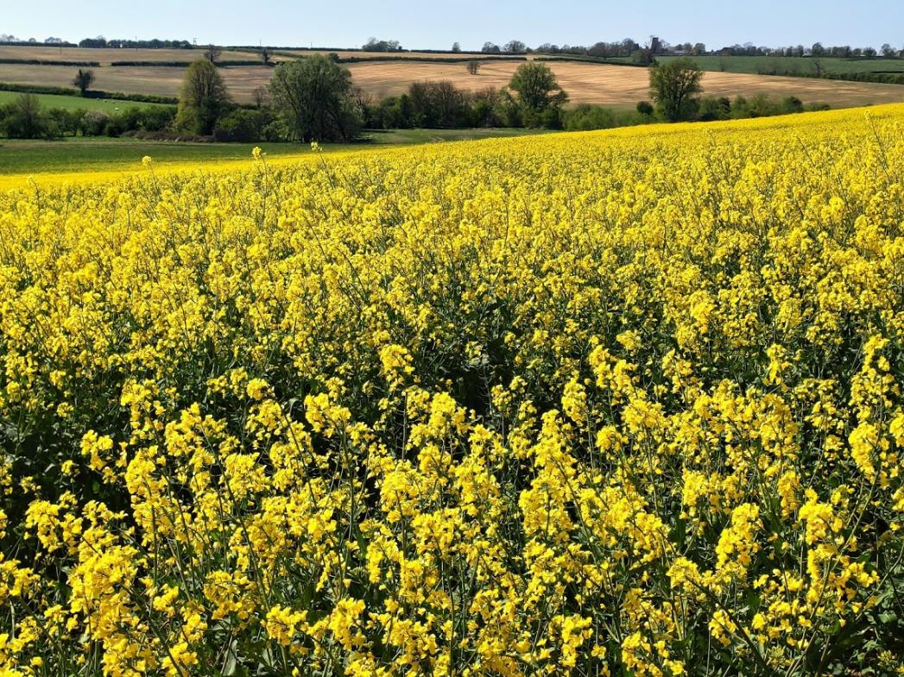
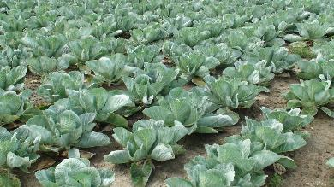
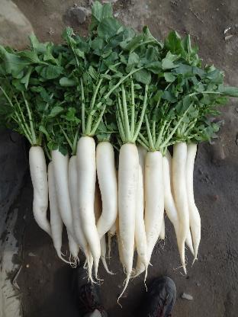
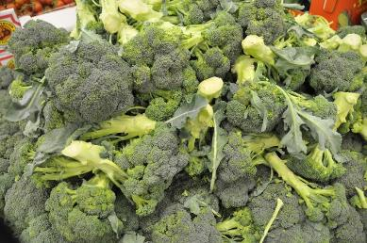
Brassica napus 2n=4x=38
AACC genome composition
B. oleracea 2n=18
CC genome
B. rapa 2n=20
AA genomes

Slide 32
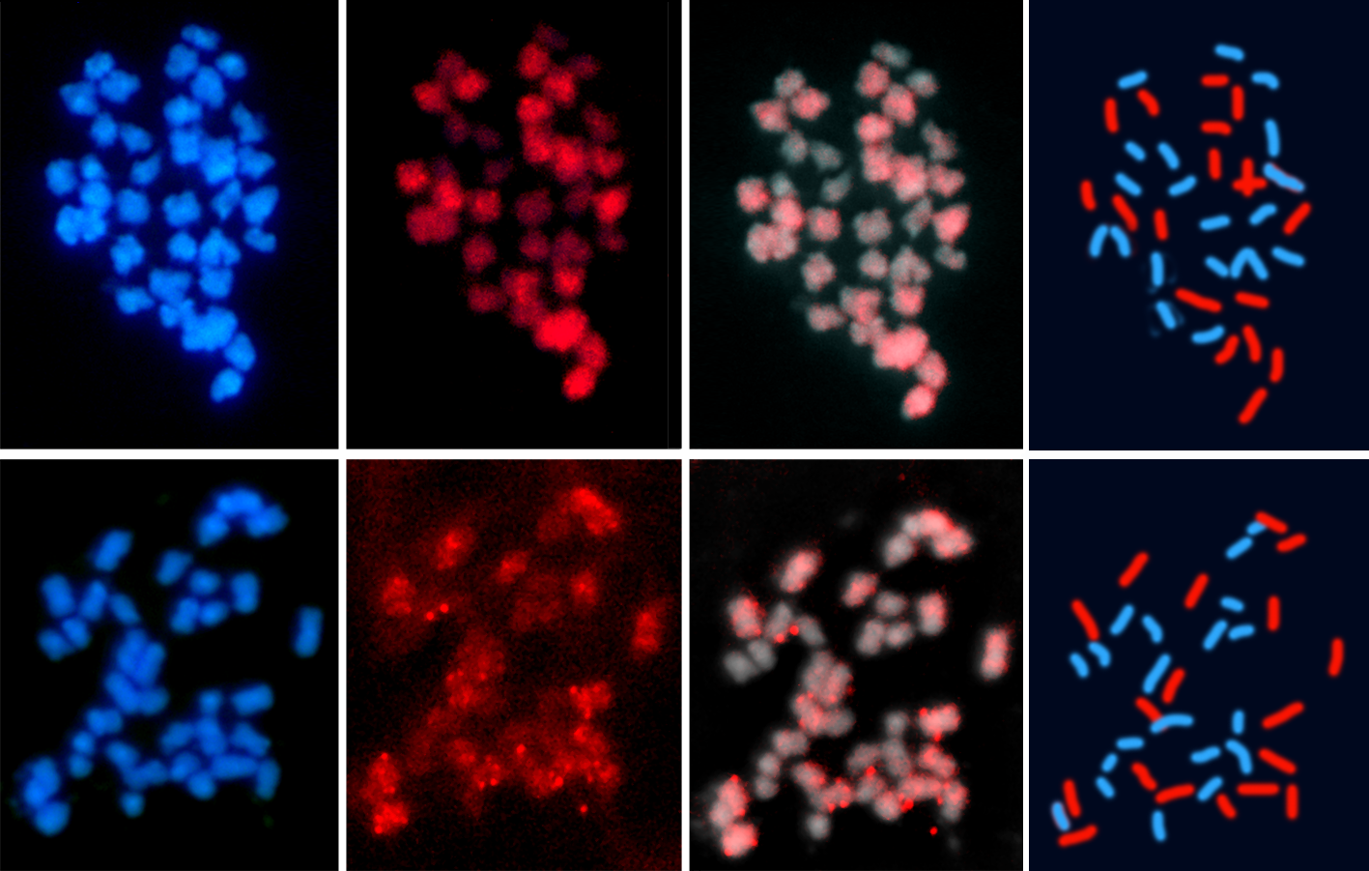
Genome Specificity of a CACTA (En/Spm) Transposon
B. napus (AACC, 2n=4x=38) – hybridized with C-genome CACTA element red
B. oleracea (CC, 2n=2x=18) B. rapa (AA, 2n=2x=20)
Karine Alix & HH

Slide 33
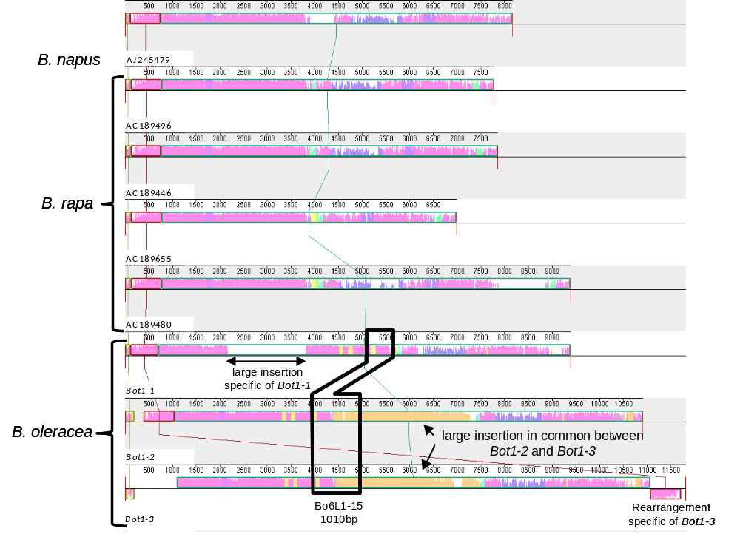
Genome Specificity of a CACTA (En/Spm) Transposon

Slide 34
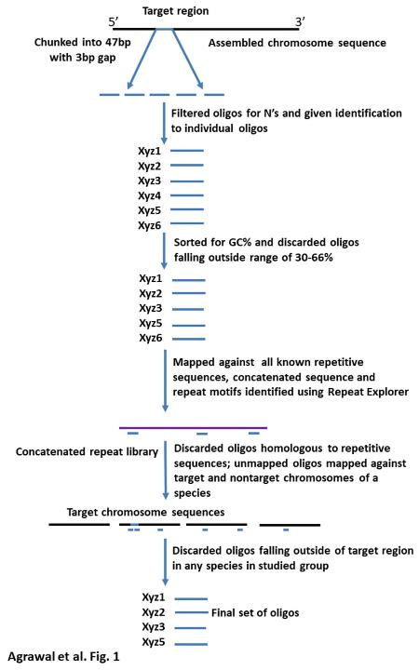
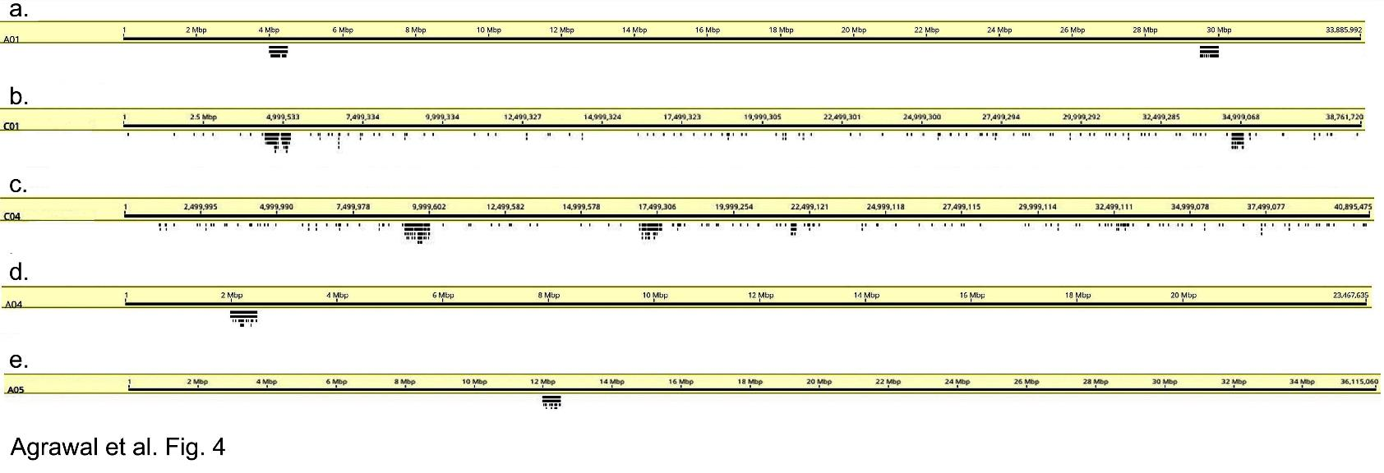
Massive oligonucleotide pools →20,000 c. 50-mers
= 1,000,000 bp

Slide 35
Oligo pool showing
translocation
B. rapa AA genome Pak Choi
cv Chiffu -401
6 labelled chrs, one has 2 sites
B. rapa AA genome
cv Purple Top Milan Turnip
8 labelled chrs, one site each
Neha Agrawal &
Surinder Banga

Slide 37
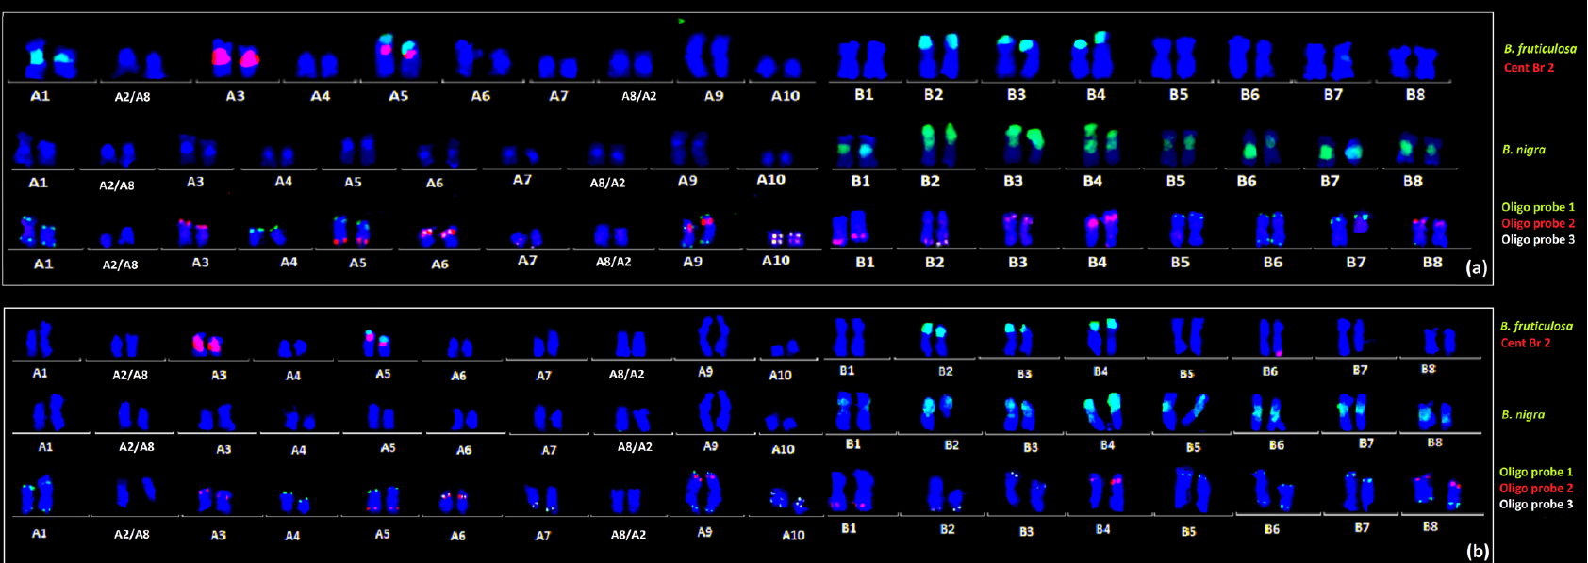
Introgression of Brassica fruticulosa chromosome segments into Brassica juncea. Lines AD101 (a) and AD64 (4)
Neha Agrawal et al.

Slide 38

Reduction in the size of introgressed chromatin in many M₃ plants (loss in one) - M₃ plants with novel patterns of chromosome segment substitutions with good agronomic performance & resistance to mustard aphid.
Graphical image of chromosomes A01, B02, B03 and B04 of three introgression lines and selected M₃ plants (introgressions are shown in red, breakdown in white)

Slide 39

Massive oligonucleotide probe pools to identify chromosomes in diploid oats and potentially more widely
R41087Bio
  HongYu Yuan,
  Qing Liu, PHH
  Also assembly quality was verified
Notes:
The group adopted the optimized labeling strategy of a massive synthetic double-stranded oligonucleotide probe library, to construct the molecular karyotype of A. longilgumis, and realized the visualization of the intercalary regions and the pericentromeric regions. Hoping to make chromosome specific across Aveneae tribe and even into BOP clade

Slide 40
3.85 Gb chromosome assembly for genome evolution
  The diploid oat Avena longiglumis Qing Liu et al.
Notes:
We assembled a chromosome-scale genome sequences of the diploid oat Avena longiglumis, 3.85 Gb. Few genes near the centromeric regions but otherwise genes to near chromosome ends A. With 87% repeats, particularly expansion of copia and gypsy retrotransposable elements in B. Comparative study of syntenic blocks shows chromosomal rearrangements from rice and Brachypodium, to diploid Tribes Triticeae and Aveneae C. And identification of gene families D. Abbreviation as EVR research is just submitted, E-genomic expansion-V structural variation, R-chromosomal rearrangements.

Slide 41
The Ancestral Grass Karyotype
  Qing Liu et al. BMC Plant Biology 2024
Notes:
We assembled a chromosome-scale genome sequences of the diploid oat Avena longiglumis, 3.85 Gb. Few genes near the centromeric regions but otherwise genes to near chromosome ends A. With 87% repeats, particularly expansion of copia and gypsy retrotransposable elements in B. Comparative study of syntenic blocks shows chromosomal rearrangements from rice and Brachypodium, to diploid Tribes Triticeae and Aveneae C. And identification of gene families D. Abbreviation as EVR research is just submitted, E-genomic expansion-V structural variation, R-chromosomal rearrangements.

Slide 42

Grass genome evolution
  from ancestral-type grasses (rice OS , Brachypodium BD) to Avena ALO
Chromosomal evolution includes nesting as well as translocations
Notes:
Avena longiglumis 3.85 Gb, with 87% of all the repeats. Genome expansion from more ancestral smaller genomes like Oryza sativa 360Mbp and Brachypodium distachyon 270Mbp with chromosomal rearrangements from including nesting of chromosomes one inside another from x=12 to x=7. But most notably, away from centromeres, uniform expansion.

Slide 43
Grass genome evolution
  Genome expansion in diploid grasses:
  from small, ancestral-type grasses (rice OS , Brachypodium BD) to Avena
Genome expansion to c. 10x larger Avena is relatively uniform from telomere to sub-centromere region
Not hypothesis of gene blocks interspersed with repeats and non-homologous terminal region
Notes:
Avena longiglumis 3.85 Gb, with 87% of all the repeats. Genome expansion from more ancestral smaller genomes like Oryza sativa 360Mbp and Brachypodium distachyon 270Mbp with chromosomal rearrangements from including nesting of chromosomes one inside another from x=12 to x=7. But most notably, away from centromeres, uniform expansion.

Slide 44


Repetitive DNA identifies genomes in forage grass polyploids
De novo identification of repeat families in Urochloa tropical forage grasses: DNA families that are amplified in some diploid genomes in polyploids.
Lizo Masters, Paulina Tomaszewska, Bat Vorontsova, Trude Schwarzacher
Abundance of repeat in sequence reads
Repetitive element
family

Slide 45

Evolutionary chromosome translocations
  Chromosome rearrangement in diploid oat Avena species
A. strigosa
A. longiglumis
A. eriantha
Multiple distal, inter-chromosome translocations occur during evolution of diploid species.
This is unlike wheat group (similar genome size)
Not like translocations in wheats (Triticeae):
Not hypothesis of a few whole-arm rearrangements
Also find similar distal inter-genomic translocations between chromosomes in derived hexaploid Avena
Notes:
We found another form of chromosome rearrangement occurs in Avena, contrasting with Triticeae wheats with similar large genome size. Avena comparative genomics shows terminal regions of about 20% of the arms including many genes exchange between chromosomes in species that have separated from common ancestors. Similarly-sized intergenomic translocations are seen in 6x hexaploid oat crop Avena sativa – now we know these happen in the diploids. In Triticeae, many fewer translocations and many are whole chromosome arms.

Slide 46

Extensive chromosome rearrangements in the Musaceae
E. glaucum
E. ventricosum
M. lasiocarpa
M. beccarii
M. Fe’i
M. acuminata
et al & Heslop-Harrison Banana Genome Hub online BGH

Slide 47

Speciation via polyploidy
  Polyploidy and its role in diversification and evolution
Chromosome number, genome size, repetitive DNA sequences, genes and regulatory sequences and their expression evolve following polyploidy – generating diversity and possible novel traits and enabling species diversification.
6x Avena sativa, oats, showing translocations & repetitive sequence homogenization in ancestral diploid genome (labelled orange, blue, green)
Heslop-Harrison JS, Schwarzacher T, Liu Q. 2023. Polyploidy: its consequences and enabling role in plant diversification and evolution. Annals of Botany 131: 1-10. https://doi.org/10.1093/aob/mcac132
Notes:
So the results in diploid oats and banana family are showing genome rearrangements occurring during speciation – reliant on chromosomal and whole-chromosome-scale genome assemblies. Polyploidy is also important, and here we discuss evidence from a range of work from us and other groups of the role of polyploidy in speciation.

Slide 48




Read length peak at 135kb Negar Karimi, Yangmeng Zhang, Hojatollah Saeidi
Elymus ciliaris Nanopore Sequencing

Slide 49



Multiple ultra-long Nanopore reads give full length chloroplast
Reference sequence Elymus ciliaris chloroplast Genbank
Typical grass
chloroplast
Single read of Nanopore
135,903bp
IRB SSC IRA
IRB SSC IRA
Inverted Repeat B/ Small Single Copy/ IR A
Genbank reference assembly has the SSC inverted between IRs (heteroplasmy)
Negar Karimi, Yangmeng Zhang, Qing Liu & PHH 2026

Slide 50


Ensete glaucum chloroplasts in ONT long reads
Egl_YM4 – 168,248 bp

Slide 51


Complexity of mitochondrial genomes
Avena longiglumis
PromethION
R9.4.1 flow cell
49.6 Gb of sequence in 2,131,575
reads were obtained
Genome length 548 kb
Multiple branches, all
supported by
single Nanopore reads
Complex, repeat-mediated structure
Sorghum bicolor
Gene exchange between the organelle genome and the nuclear genome of A. longiglumis has undergone a continuous and dynamic evolutionary process
BMC Plant Biology, 2023, 23, 218
Notes:
We also reconstructed the complex mitochondrial genome A. longiglumis, with long-molecule sequencing showing present of multiple alternative structures with repeat-mediated recombination. The total length was a large 548 kb, with only 39 protein-coding genes. A comparison of mitochondrial genomes with 23 Poaceae species showed that the gene exchange between the organelle genome and the nuclear genome of A. longiglumis has undergone a continuous and dynamic evolutionary process. Notably, building phylogenies based on sequences and the presence-or-absence of genes gave no sensible trees: not even the major Poaceae clades of PACMAD (Panicum/C4) and BOP

Slide 52


Slide 53

Musella lasiocarpa: t2t assembly
of haplotypes
PlotSR

Slide 54



MLA08
45S
Mlcen
Mb
Position MLA08.2/6,129,900
Rearrangements often involve repetitive sequences, in particular retroelements

Slide 55


Slide 56



Hamdani
Karadi
Whole genome survey sequencing
2x150bp Illumina HiSeq
Five animals
Each c. 6 Gb, 2x genome coverage, 44million reads

Slide 57

Sarbast Mustafa

Slide 58

Mitogenome sequence probes on chromosomes of sheep (2n=54)
Elymus forage grass: Heteroplasmy
Sheep: NUMT – Nuclear-Mitochondrial Transfer

Slide 59

Ran Li, PHH, et al., 2023. A sheep pangenome reveals the spectrum of structural variations and their effects on tail phenotypes

Slide 60

A novel insertion in the 5′ untranslated region (5′ UTR) of HOXB13 is found in fat/long-tailed sheep

Slide 61


5S rDNA and 45S rDNA
eg05
eg06
Musella lasiocarpa
Ensete glaucum
45S rDNA
5S rDNA
5S rDNA
ml05
ml06
ml08
45S rDNA
Trude and Dongli 2024

Slide 62
Evolution of rDNA – genes and spacers
45S rDNA repeat unit: typically 10kb monomer
18S
ITS1
5.8S
ITS2
26S
NTSL
MuTR
NTSR
5S rDNA repeat unit: typically 500bp monomer
5S
ITS
Sequence and length of monomer (PacBio >yr 2022)
Number of loci of arrays (in situ hybridization FISH & high quality assemblies)
Organization of arrays on chromosomes (FISH & assembly)
Number of monomers in array (FISH; total in cell by Illumina reads; 2025 struggling with assembly)
Evolution and variation of monomers in arrays

Slide 63





45S rDNA repeat unit in Musella lasiocarpa and Ensete glaucum
18S
ITS1
5.8S
ITS2
26S
NTSL
MuTR
NTSR
STR
Oh dear! – Impossible to assemble from shorter reads
Illumina 150bp; PacBio 15kb
ZiWei Wang, Qing Liu

Slide 64


Slide 65


ITS2
26S
STR
18S
ITS1
5.8S
NTSL
MuTR
NTSR
18S
ITS1
MuTR
NTSR

Slide 66


Farming – Pharmaceuticals
Ensete ventricosum is a staple starch crop for 50 million people in Ethiopia
Also widely used as a traditional medicine
Farmers propagate and grow specific cultivars for medicine
Hypotheses
Medicinal cultivar diversity is greater than starch cultivars
Starch cultivars are in a different diversity pool
Villages use different names for one cultivar, or the same name for different cultivars
BF for bone fracture; BI, back injury;
DP, discharge of placenta;
SD, skin itching and diarrhea;
NM, non-medicinal;
ET, expulsion of thorn/drainage of abscess;
LD, liver disease; OD, other diseases.

Slide 67

Our hypotheses all wrong!
Starch cultivars same pool and as diverse as medicinal cultivars
Duplicate named-accessions were the same; names were unique genotypes
WRONG!
Light Green: Starch Staple Crop Cultivars
BF for bone fracture; DP, discharge of placenta; BI, back injury; SD, skin itching and diarrhea; NM, non-medicinal; ET, expulsion of thorn and drainage of abscess from tissue; LD, liver disease; OD, other diseases.

Slide 68


Our Plants

Slide 69


The Rhizosphere and Microbiome Trends in Plant Science April 2025

Slide 70





Slide 71



Exploit positive (avoid negative) epistatic & pleiotropic interactions plant breeding
Developing avenues of artiﬁcial intelligence, novel exploitation of large-scale genomics & phenomics data
Find genes with minor effects to analyse epistatic interactions and pleiotropic QTLs accounting for missing heritability

Slide 72
What has farming and agriculture done
Food
Feed (Forage)
Fuel
Fibre
Feedstock
Flowers (Fun)
Pharmaceuticals
The Seven F’s of Farming

Slide 73

The population explosion of the last 100 years
BUT…

Slide 74


Now we live in a different situation …
China: population declining
Rest of Asia: no increase
Europe/Americas/ Australasia: no increase
Africa is only area increasing now

Slide 75
My messages
Agriculture grows more, better, food for the expanded world population
Agronomy (how crops & animals are grown) and Genetics delivered the improvement (not more labour or more land; smaller from supply chain)
BUT
This has been achieved at and unsustainable cost to the planet
Biodiversity – all the plant and animal species and their variants – underpins the increase in food production
Agriculture now is destroying biodiversity, the land, and the climate
NOW there is no population increase, we must continue the improvements in agriculture, but dedicate them to conservation and improving the world
Biodiversity, Conservation and Agriculture: Breeding
Supported by molecular cytogenetics, knowledge of genome evolution and DNA/RNA sequencing

Slide 76
Genes

Slide 77
Organelle sequences
from chloroplasts or
mitochondria
Nuclear
Genome
Genes, regulatory and non-coding low-copy sequences
Sequences from viruses
Transgenes introduced with molecular biology methods
Repetitive DNA sequences
45S and 5S rRNA genes
Other genes
Tandem repeats
Satellite sequences
Repeated genes
Dispersed repeats
Simple sequence repeats or microsatellites
Transposable elements
Blocks of tandem repeats at discrete chromosomal loci
Structural components of chromosomes
Retrotransposons
DNA transposons
Dispersed repeats that we don’t know about – except each is significant proportion of genome
Autonomous/ non-autonomous
Subtelomeric repeats
Centromeric repeats
Telomeric repeats
DNA sequence components of the nuclear genome
After Biscotti et al. Chromosome Research 2015

Slide 78
What has genetics, plant and animal breeding, farming and agriculture done (1)
Provided more (and better) food to more people
Used no more land
  No more is being made! And all that is suitable is being farmed
  (but some of the most diverse areas are not suitable)
No greater exploitation of wild species
  Collection, including fish, medicine & spices, leads to extinction
Much less labour
  Your great-great grandparents were likely to br farmers or agricultural labourers, working 12 hours per day, under sun, rain, heat, cold

Slide 79
What has genetics, plant and animal breeding, farming and agriculture done (2)
Destroyed good land – erosion of soil, salinity salt
Used more water than is available
Caused pollution (fertilizer; crop protection chemicals)
Caused climate change (global warming)
All four threaten biodiversity and cause species extinction

Slide 80


Slide 81



My main messages
Agriculture grows more, better, food than ever but has environmental impact
Agronomy (how crops & animals are grown) and Genetics delivered the improvement (not more labour or more land)
Biodiversity, Conservation and Agriculture

Slide 82
What cytogenomics has, is and will do for agriculture in our world
Pat Heslop-Harrison
phh@molcyt.com
www.molcyt.org
Plant molecular cytogenetics
Nîmes ECA Course
29 March 2026
A flavour of the tricks our species show and how we study them
Animal, Plant and Comparative Cytogenomics

